Slide 1


EnlightenDS:
Advanced Technologies for Skill Enhancement & Talent Recognition in Children with Down Syndrome
Presented by:
24-25J-228

Slide 2
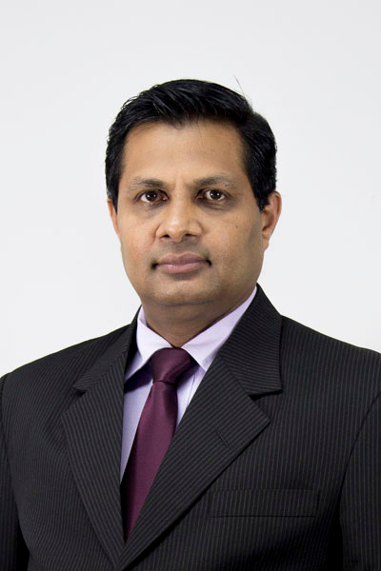




Supervisory Details
Prof. Samantha Thelijjagoda
Dr. Junius Anjana
Dr. Kamalani Wanigasinghe
Doctor at Senehasa Research Centre
Supervisor
Co-Supervisor
External Supervisor
IT21293030 Jayasuriya S.H. 25J-228
2

Slide 3
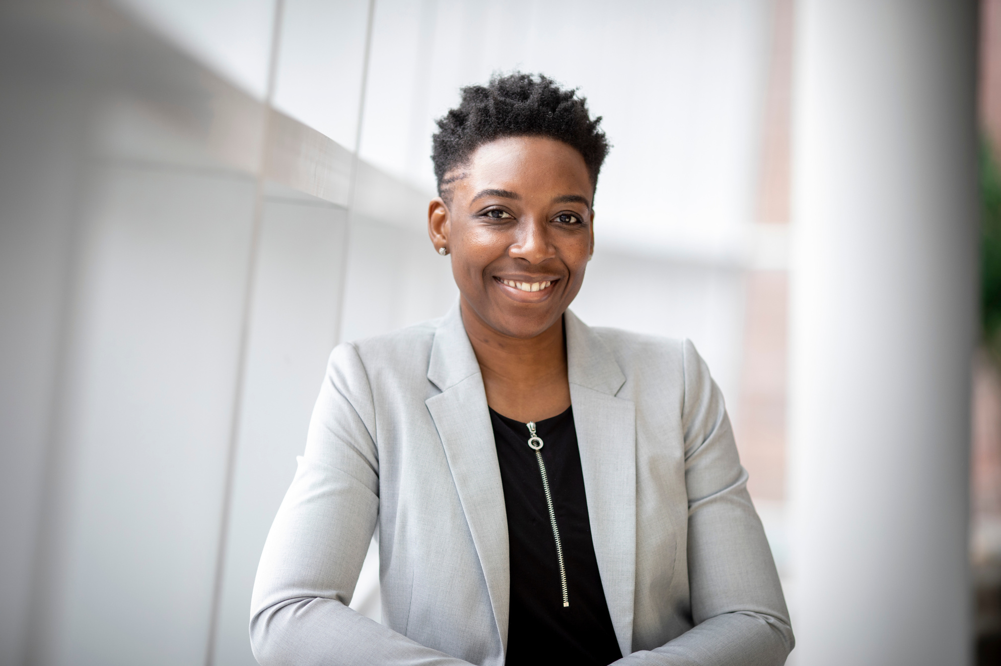
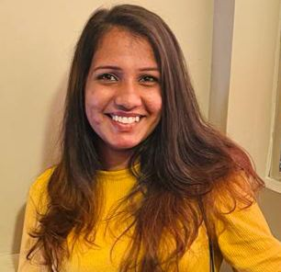
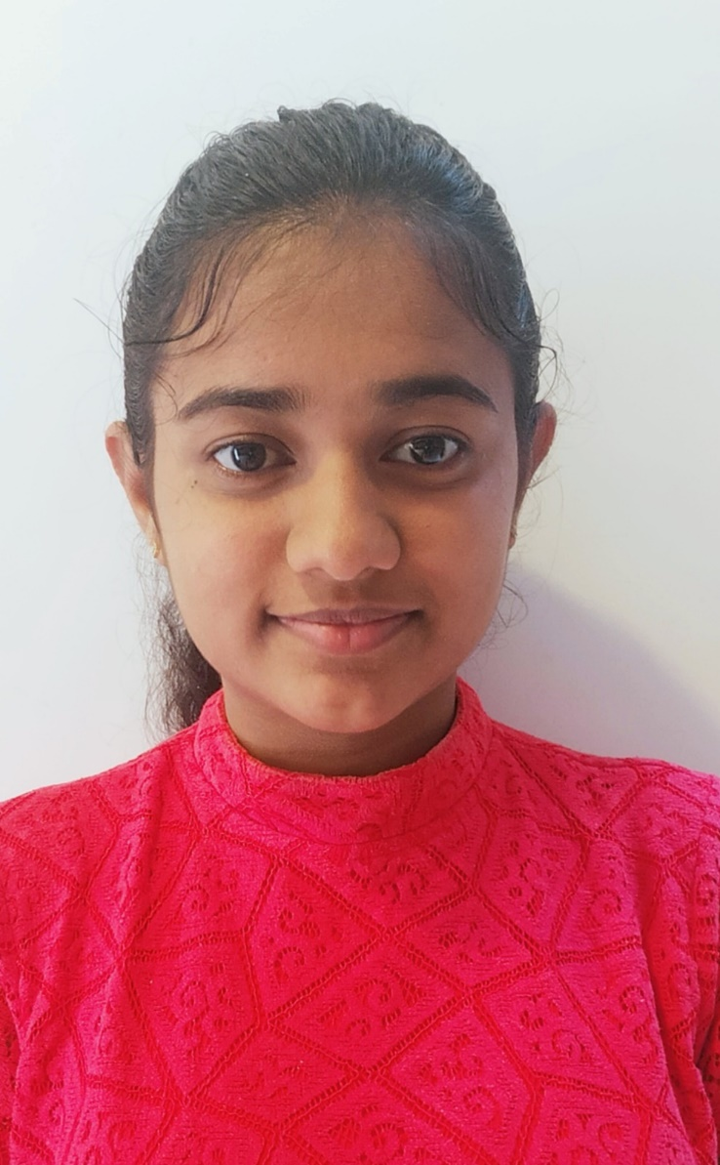

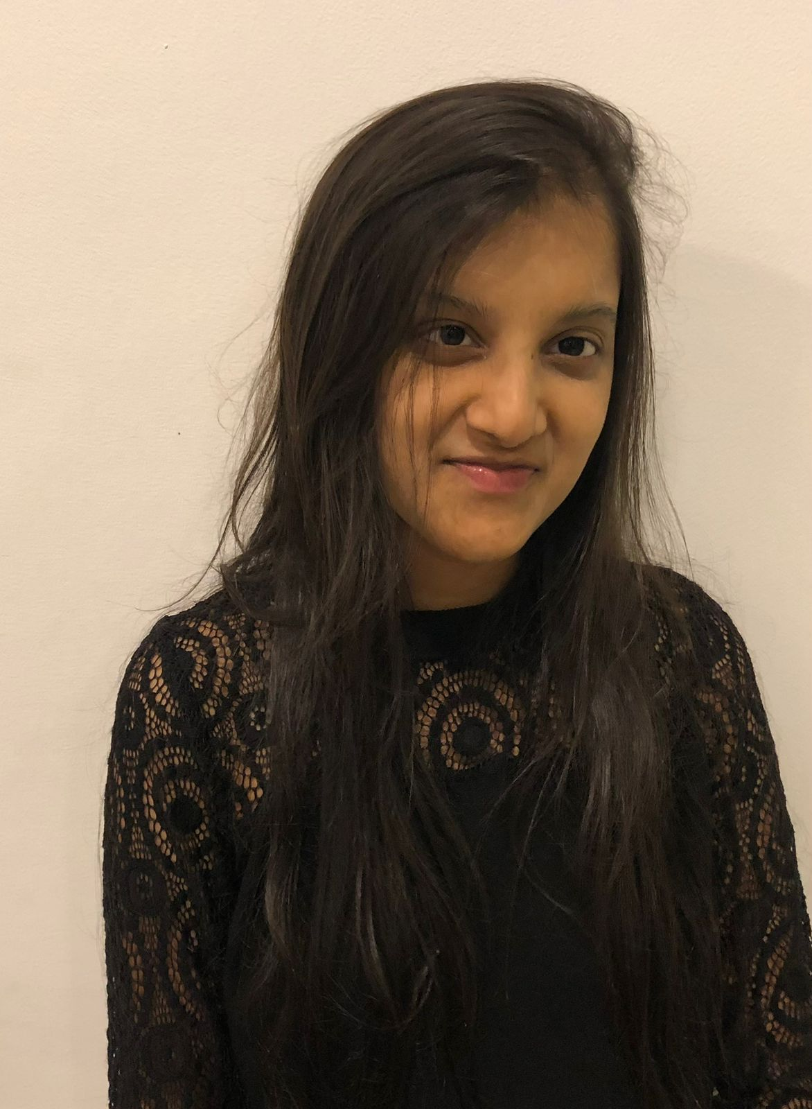
Team Members
Kumarasinghe D.P Jayasuriya S.H
Semini B.V.S Methsahani K.K.S.P
IT21296314
IT21293030
IT21342394
IT21292972
IT21293030 Jayasuriya S.H. 25J-228

Slide 4
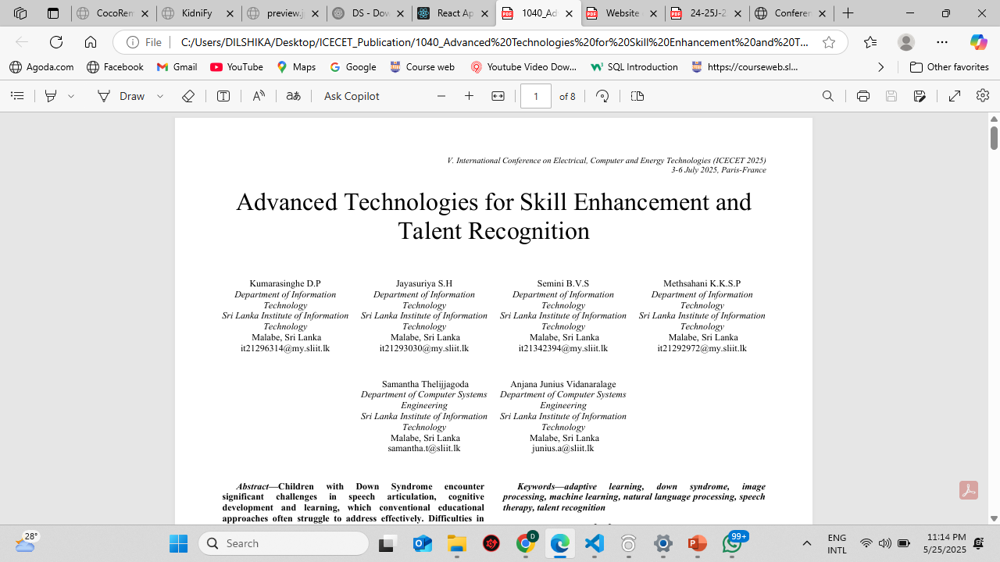
Research Paper

Slide 5
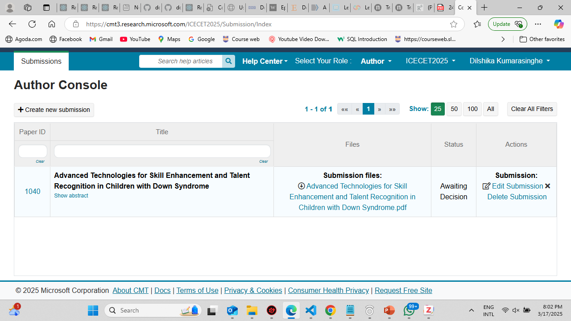
Research Paper submitted to ICECEC

Slide 6
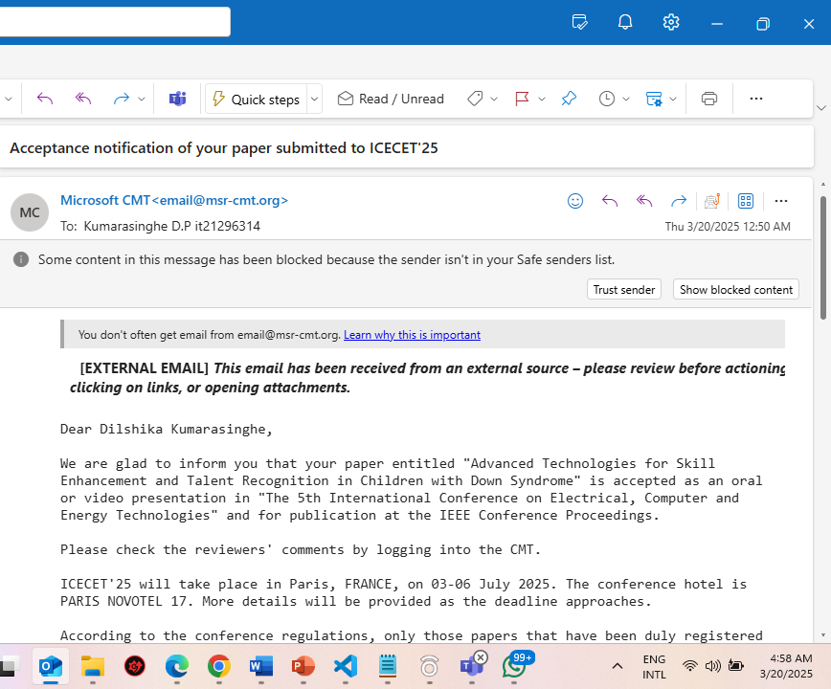
Acceptance Notification
01
Peer – Reviewed by 7 people

Slide 7
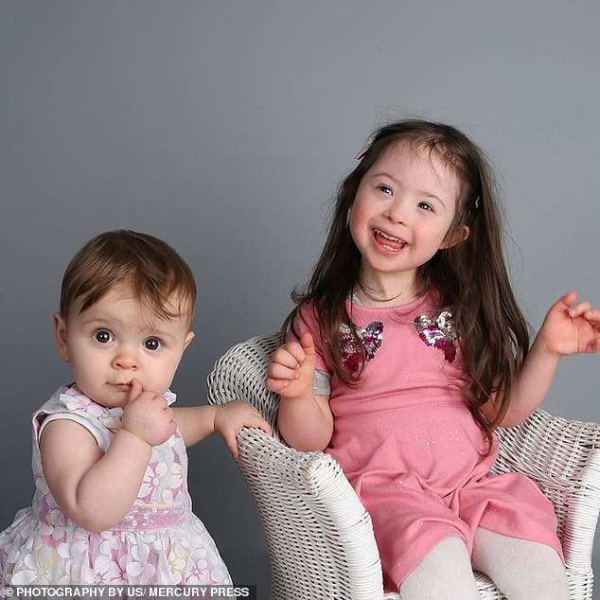
Background
01
Genetic disorder caused by an extra chromosome 21 [1]
02
Affects approximately 1 in 700 births globally [2]
03
Leads to developmental delays and intellectual disabilities and requires tailored interventions for cognitive and personal growth [3]
04
Designed for children with Down syndrome aged 5-15.

Slide 8

Research Question
RQ 1 : How can we assess the detection of Down Syndrome in children?
RQ 2 : What innovative techniques can be employed to improve pronunciation & mathematical skills in Down Syndrome children?
RQ 3 : How can we identify and nurture artistic talents in children with Down syndrome?

Slide 9


Main Objective
01
Assess the detection of down syndrome
Create a system that supports the detection, mathematical and creative development of children with Down syndrome, aged 5-15 through personalized and adaptive educational interventions.
03
02
Improve pronunciation skills
03
Enhance mathematical skills
04
04
Identify and nurture artistic talents
05
06

Slide 10
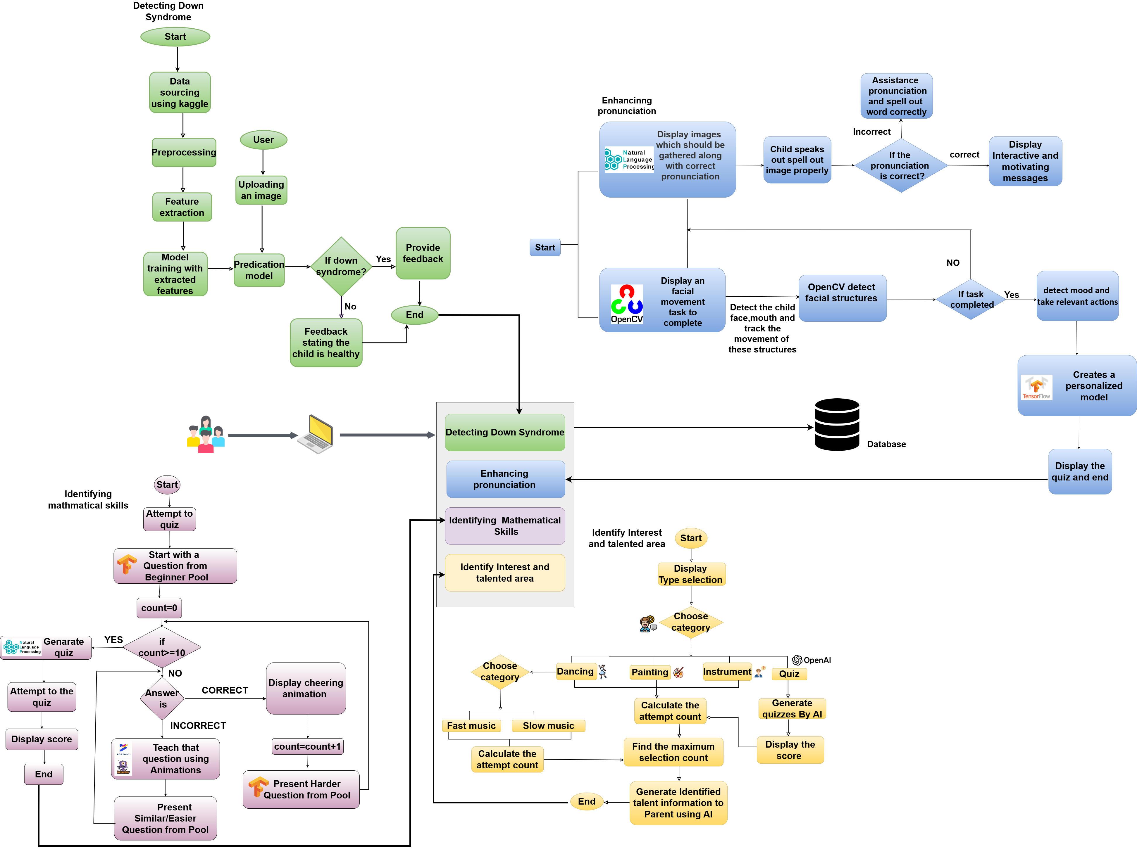
System Diagram

Slide 11
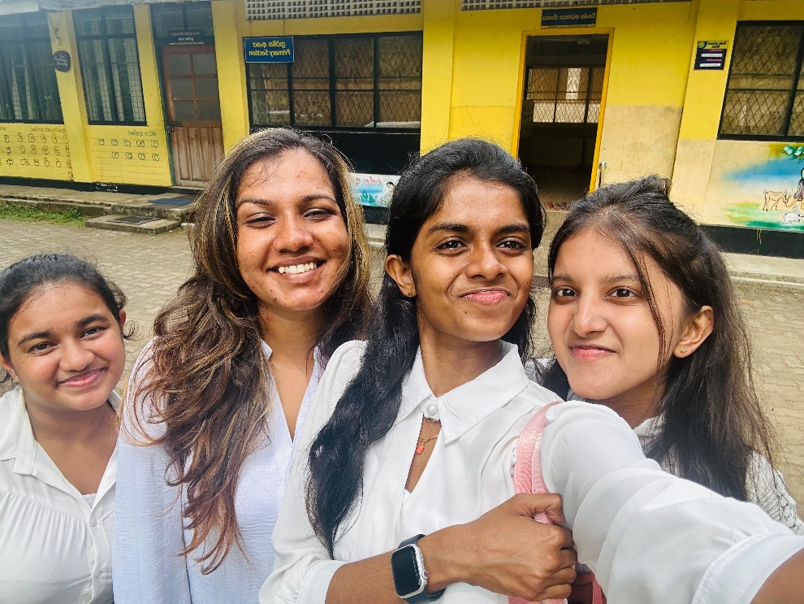

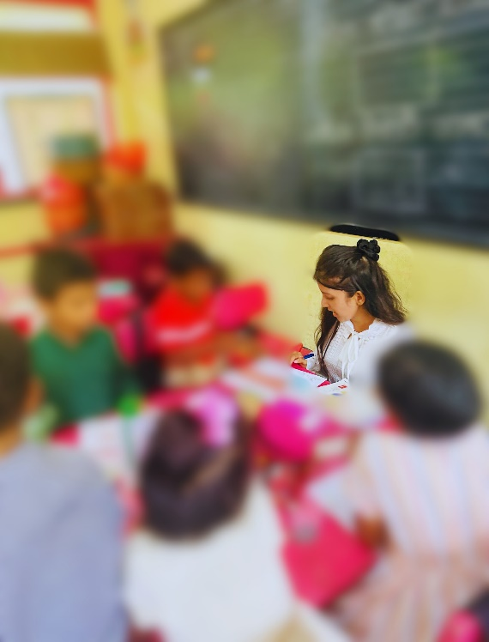
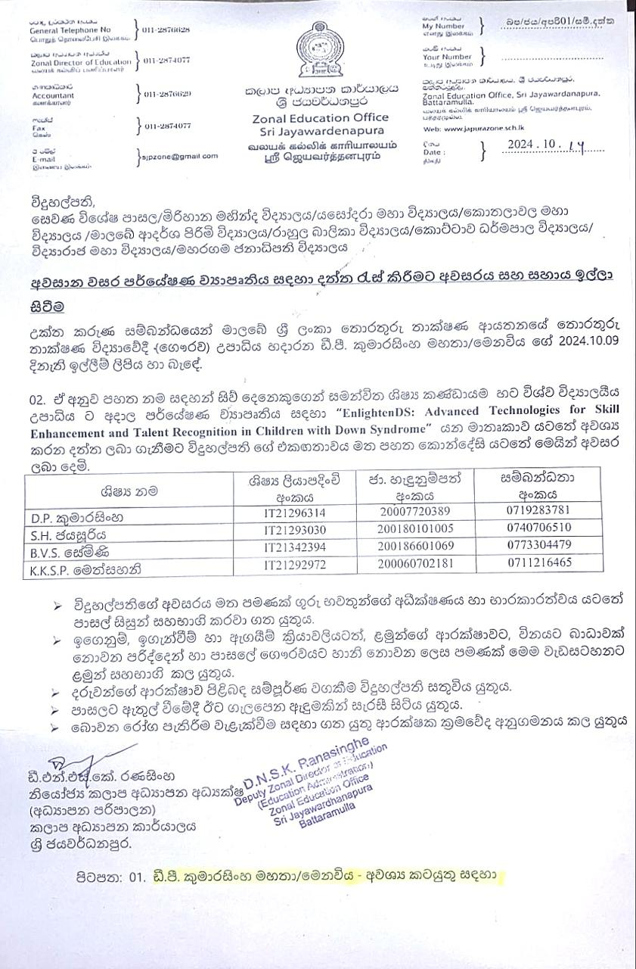
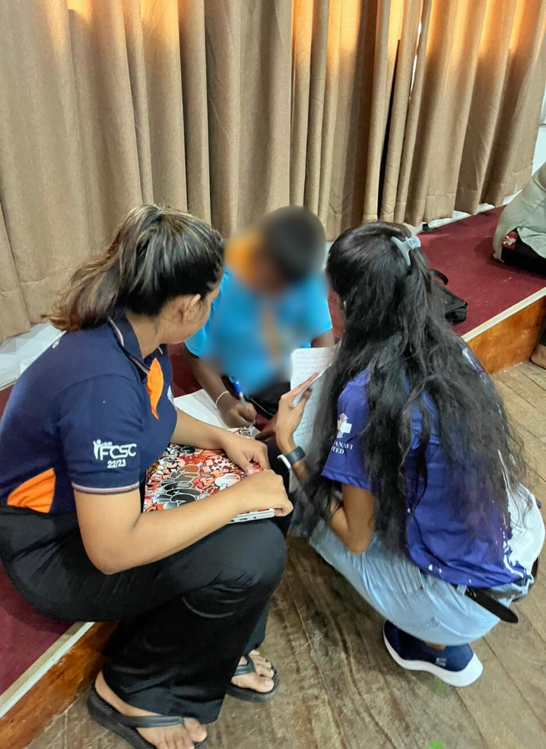
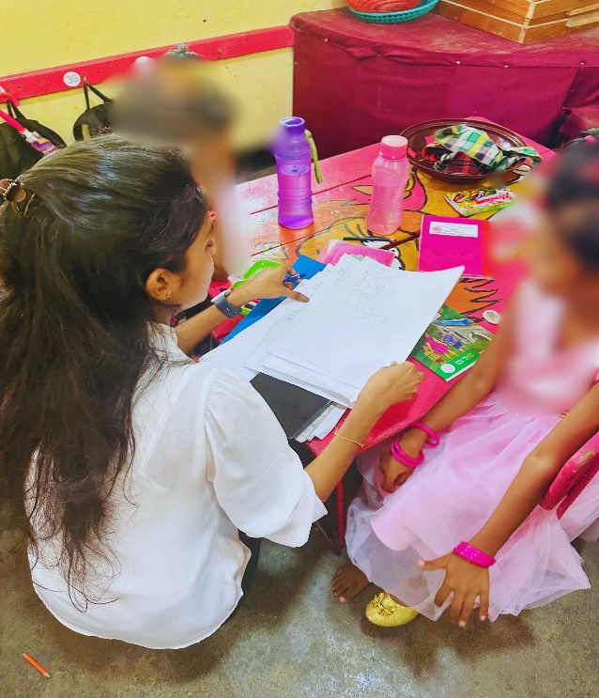
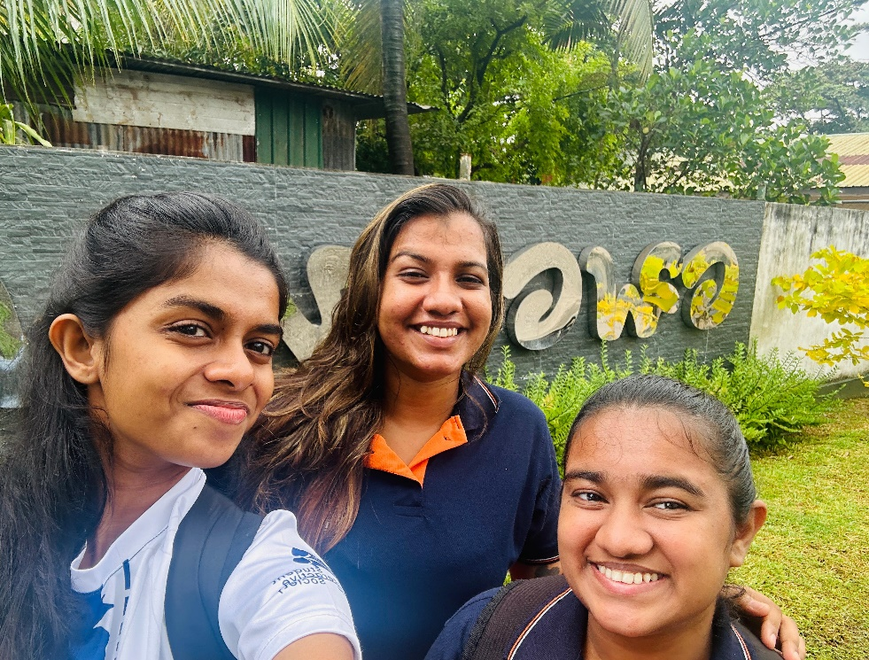
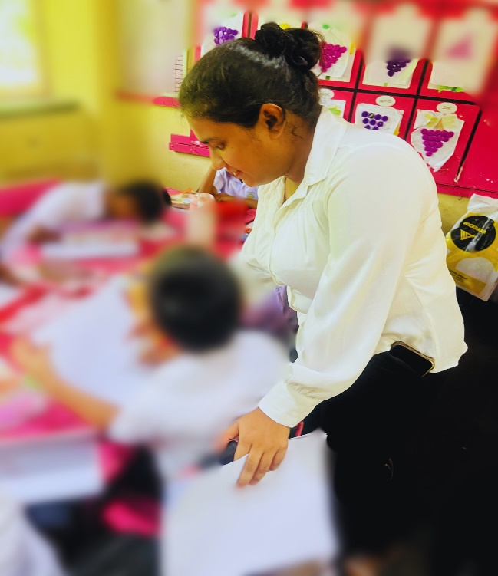
Data Collection

Slide 12
Risk Mitigation
Risk | Risk Mitigation
Privacy and ethical concerns when collecting and storing sensitive data about children | Completed the ethical clearance form, obtained permission from the zonal education office and ensured anonymization of data to protect privacy
Some parents hesitated to give consent for their children to participate | Hold sessions to inform parents about the project’s purpose, benefits and data privacy measures
Children may lose interest in using the tools or platforms over time | Decided to add interactive, gamified features and variety to maintain engagement
Resistance or lack of interest from educators, therapists and parents | Create awareness campaigns highlighting the benefits of the proposed solutions.

Slide 13



Commercialization Plan
Basic Plan
Free
Premium Plan
$10 /month
School Plan
$30 /month
Detection mechanism.
Basic communication improvement activities.
Limited personalized quizzes for math.
Painting and piano platforms.
Basic summary reports
All features from the Basic Plan.
Full access to personalized quizzes
Emotion-based activities and mood detection.
Advanced summary
Full access to all features from Premium package
Up to 40 students

Slide 14
Budget
Component | Amount(LKR)
Travelling cost | 10000
Server & Hosting charges | 25000
Bandwith | 15000
Total | 50000

Slide 15
References
[1] A. Saini, “Enhanced Detection of Down Syndrome Through Convolutional Neural Networks: A Deep Learning Approach,” in 2025 6th International Conference on Mobile Computing and Sustainable Informatics (ICMCSI), Jan. 2025, pp. 1583–1587. doi: 10.1109/ICMCSI64620.2025.10883612.
[2] (“ Young children’s spontaneous utterances of mental terms and the accuracy of their memory behaviors: a different methodological approach - Cherney - 2003 - Infant and Child Development - Wiley Online Library.” Accessed: Aug. 11, 2024. [Online]. Available: https://onlinelibrary.wiley.com/doi/10.1002/icd.267 )
[3] (“Frontal electroencephalogram asymmetry during affective processing in children with Down syndrome: a pilot study - Conrad - 2007 - Journal of Intellectual Disability Research - Wiley Online Library.” Accessed: Aug. 11, 2024. [Online]. Available: https://onlinelibrary.wiley.com/doi/10.1111/j.1365-2788.2007.01010.x )
IT21296314 | Kumarasinghe D.P. | 24-25J-228

Slide 16

IT21296314 | Kumarasinghe D.P.
Specialization : Information Technology
Assessing the detection of down syndrome
IT21296314 | Kumarasinghe D.P. | 24-25J-228
IT21293030 Jayasuriya S.H. 25J-228

Slide 17
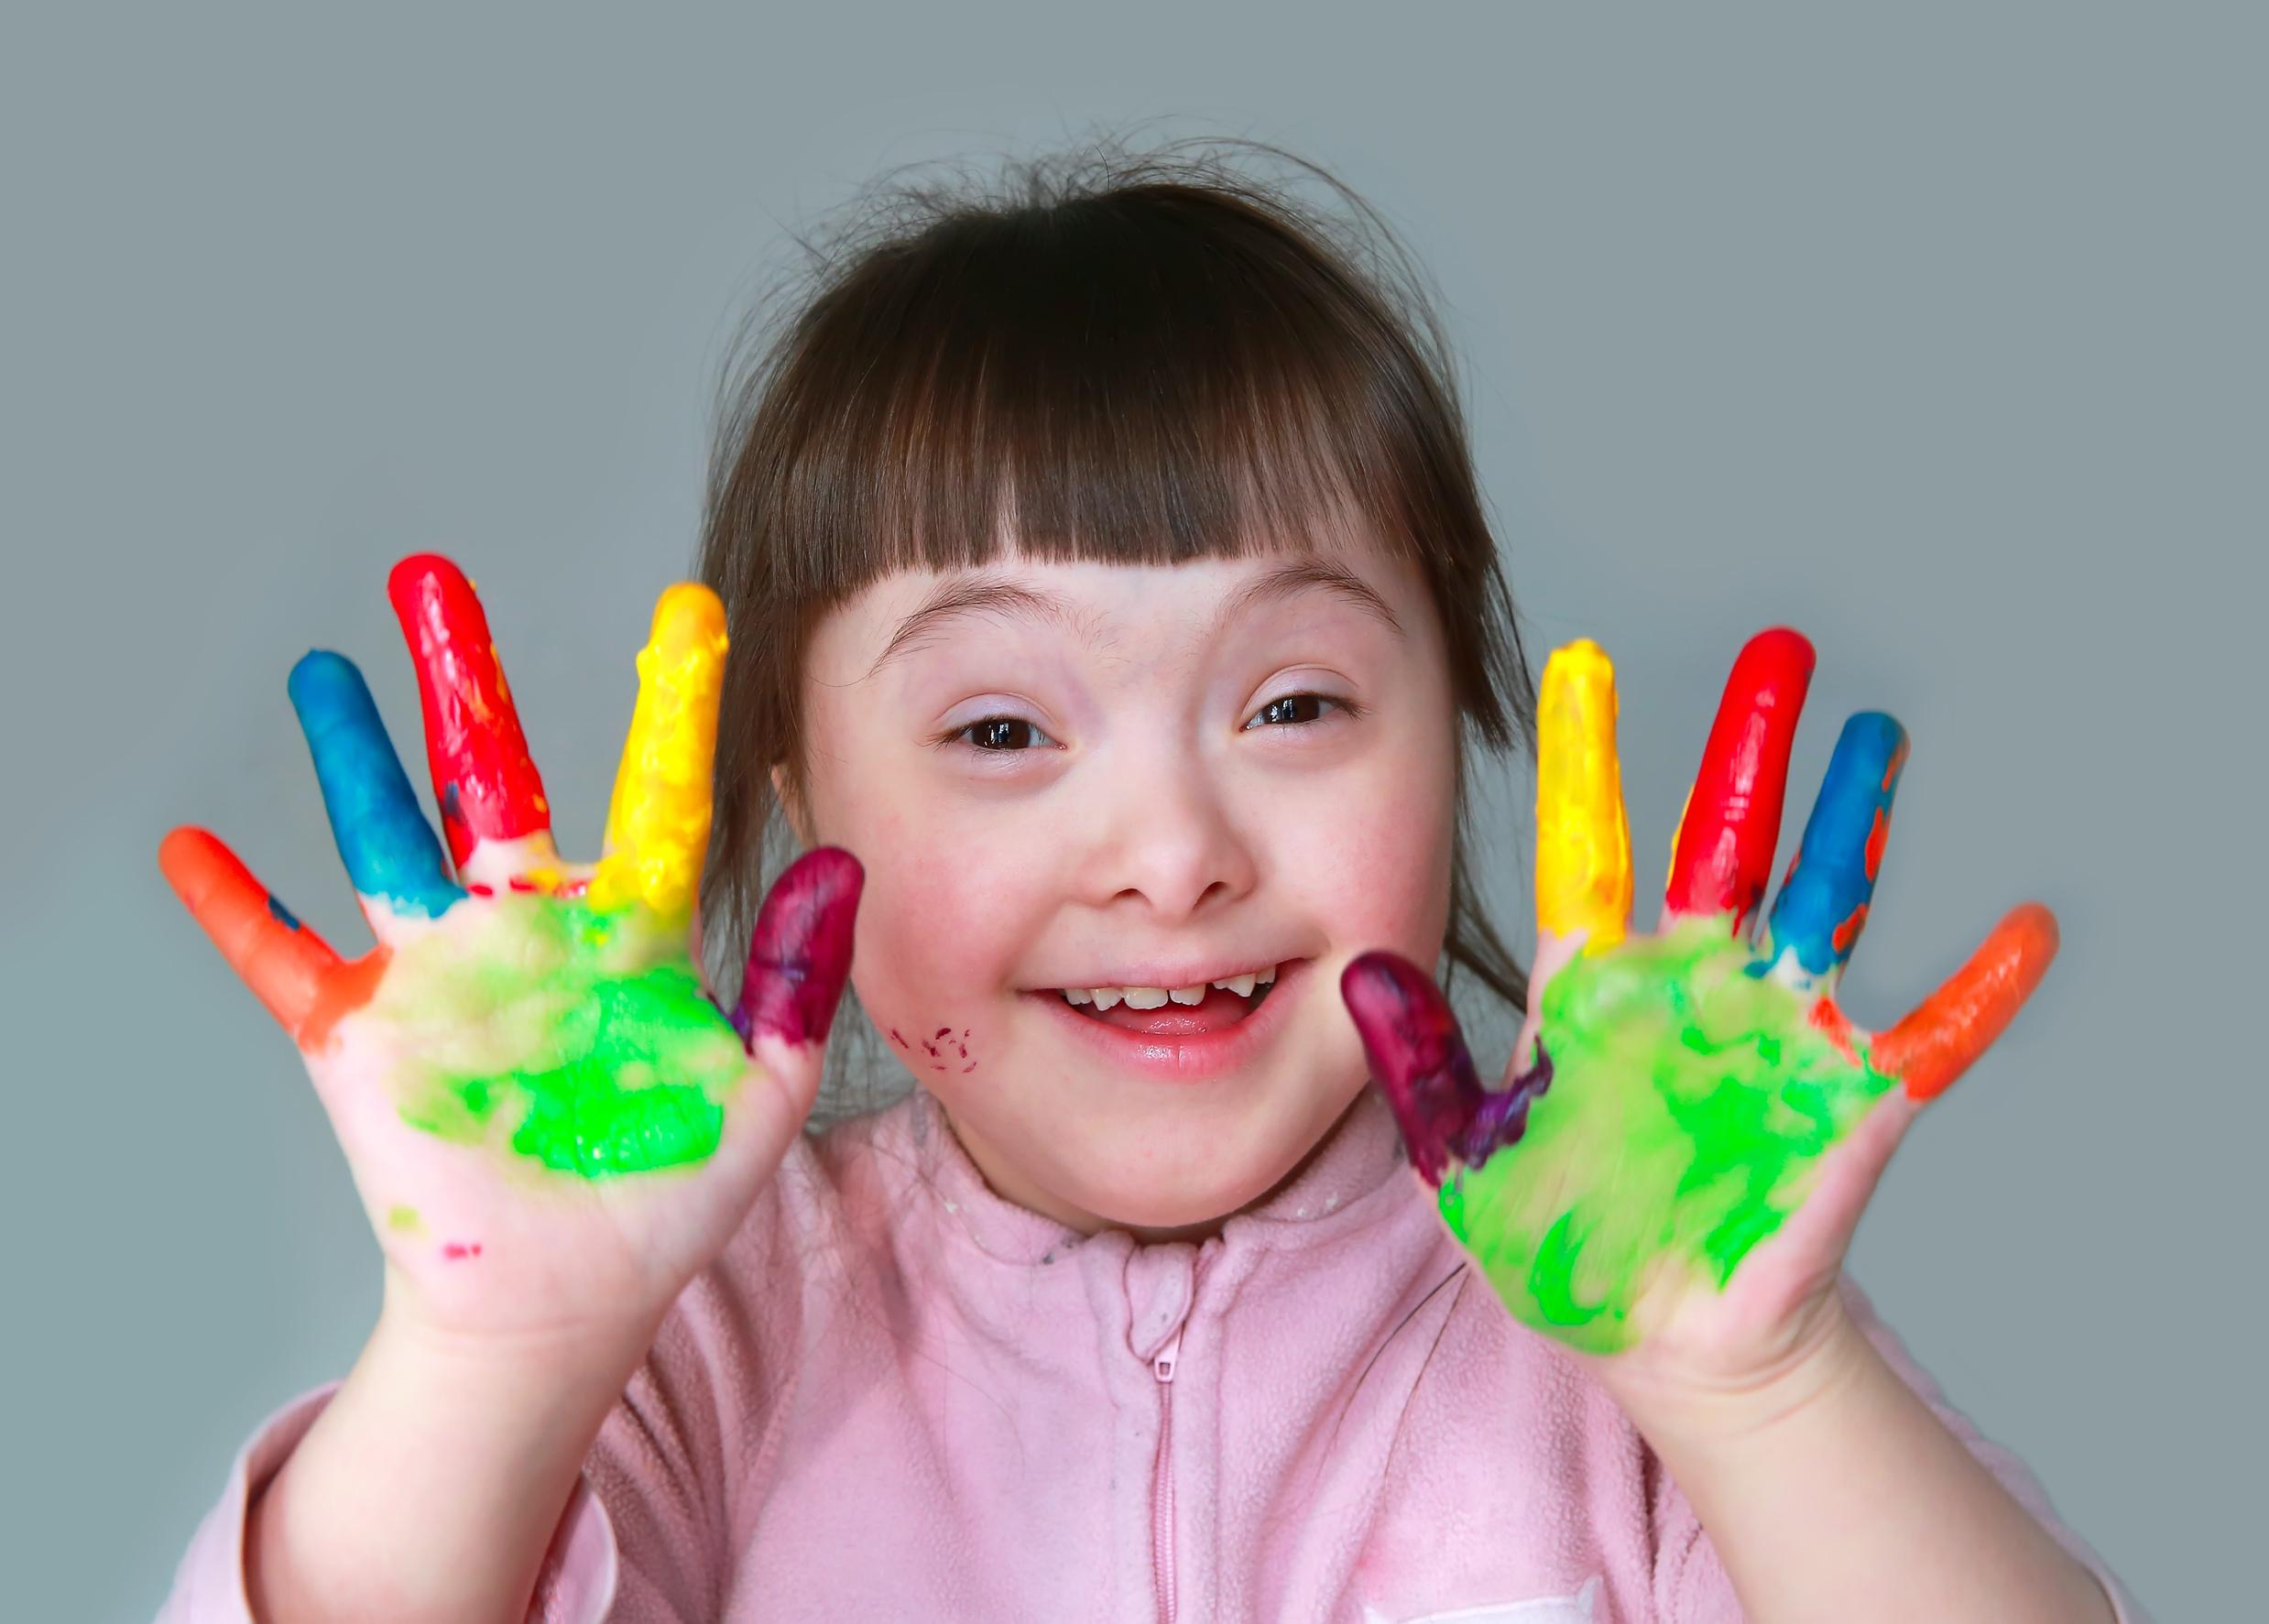
Background
Progression of thinking, learning, memory, and problem-solving
01
02
Hard for them to connect with others, perform well in school and build confidence
03
Typically involves mild to moderate intellectual disabilities [4]
04
Delays in speech, communication, memory issues, attention deficits, and difficulty with abstract thinking [5]
IT21296314 | Kumarasinghe D.P. | 24-25J-228

Slide 18
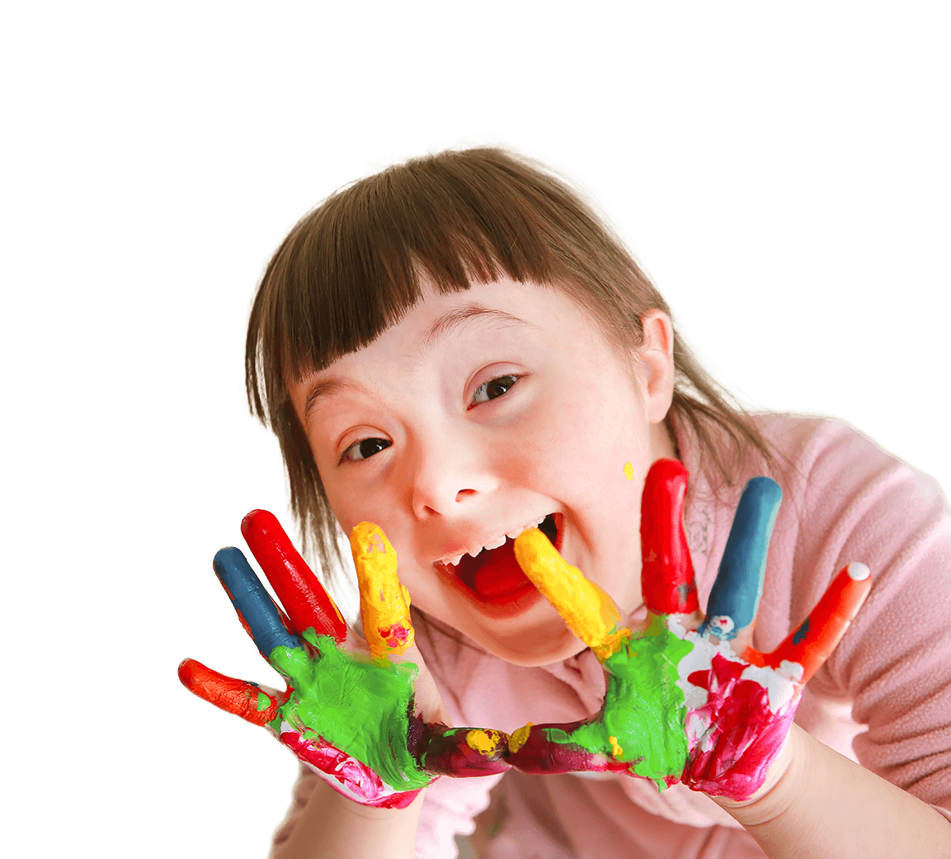
05
Affects education, social skills, and quality of life
06
Crucial for effective educational strategies
07
To assess detection of down syndrome accurately, ensuring proper support for children with Down syndrome to succeed academically and socially [6]
IT21296314 | Kumarasinghe D.P. | 24-25J-228

Slide 19


Research Gap
Features
[7]
[8]
[9]
[10]
Used image processing
Used SVM
Web based application
Gender not biased
[7] July 2024,” An Android Augmented Reality Application to Improve Cognitive Skills in Color Recognition for Down Syndrome children
[8] December 2023, “BENDI: Improving Cognitive Assessments in Toddlers and Children with Down Syndrome Using Stealth Assessment
[9] November 2018, “Motor and cognitive development of children with Down syndrome: The effect of acquisition of walking skills on their cognitive and language abilities
[10] February 2020, “Cognitive Impairments in Children with Down Syndrome
IT21296314 | Kumarasinghe D.P. | 24-25J-228

Slide 20


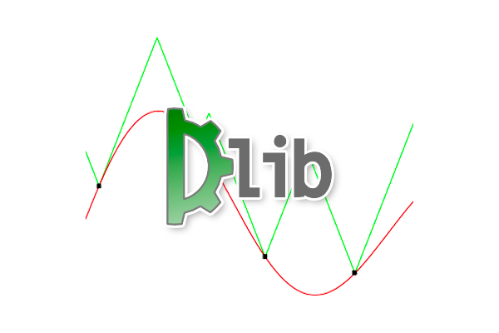


Technologies
React
Support Vector Machine(SVM)
JavaScript libraries
Dlib
Python
IT21296314 | Kumarasinghe D.P. | 24-25J-228

Slide 21

Key Pillars
Google Colab
Support Vector Machine(SVM)
Machine
Learning
Image
Processing
IT21296314 | Kumarasinghe D.P. | 24-25J-228

Slide 22


PP2 to Final progress
Addressing Panel Feedback
Improved overall model accuracy through fine-tuning
Displayed the identified landmarks directly on the uploaded images for better interpretability and validation
0
100%
User Interface Improvement
Redesigned the user interface
IT21296314 | Kumarasinghe D.P. | 24-25J-228

Slide 23
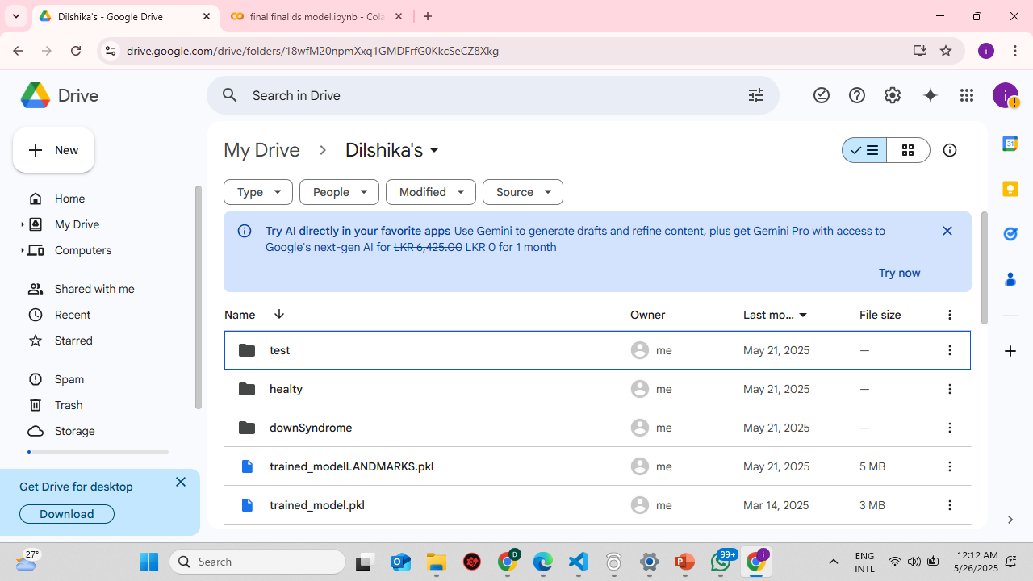
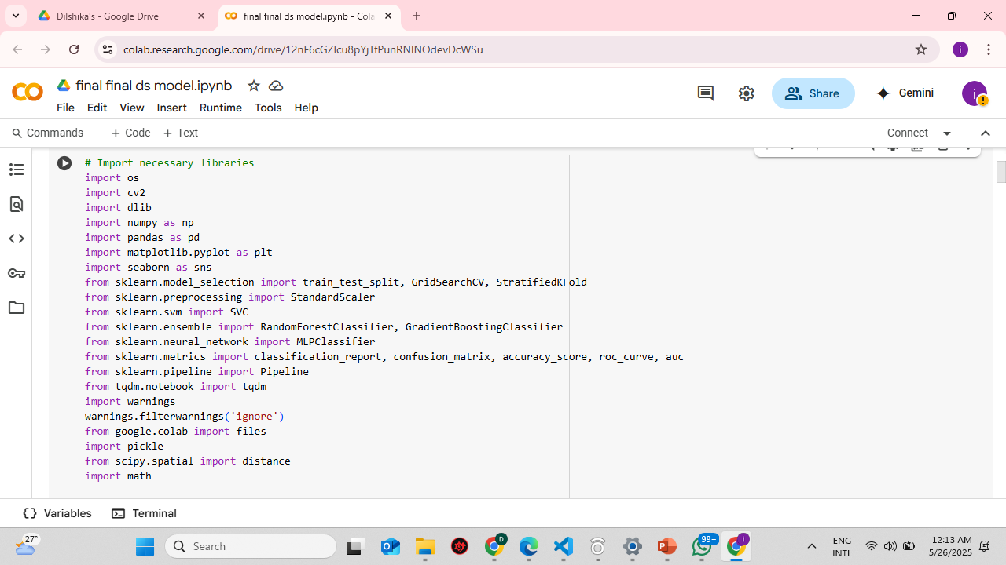
Proof of Concept
Training & Testing datasets are stored in the google drive and importing necessary libraries
IT21296314 | Kumarasinghe D.P. | 24-25J-228

Slide 24
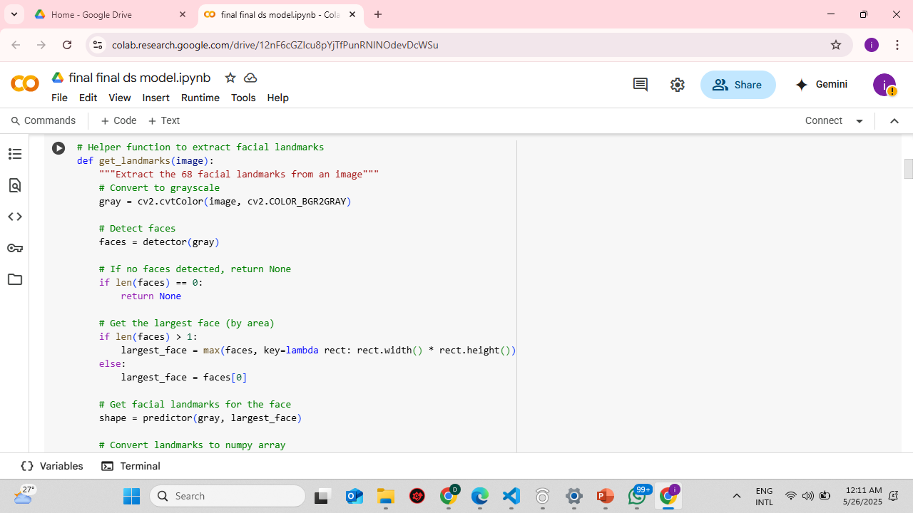
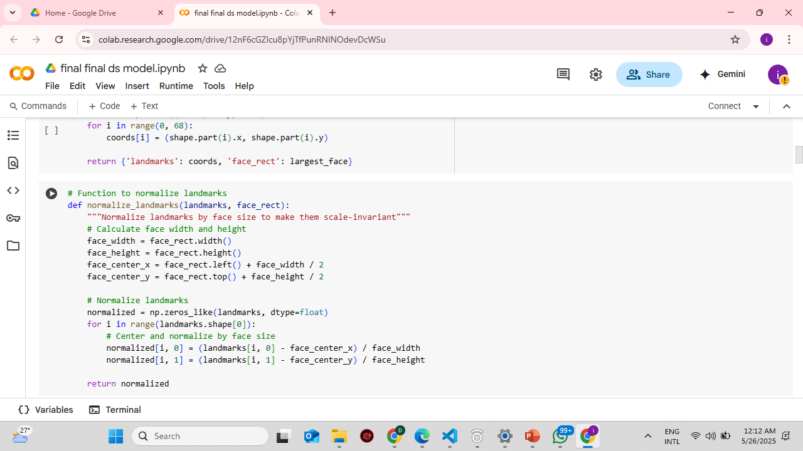
Proof of Concept
Extracted facial landmarks
IT21296314 | Kumarasinghe D.P. | 24-25J-228

Slide 25
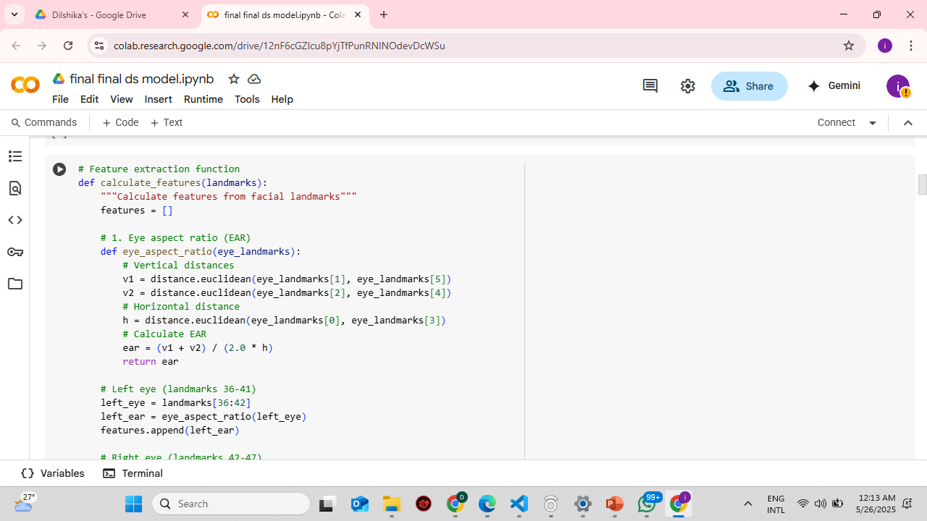
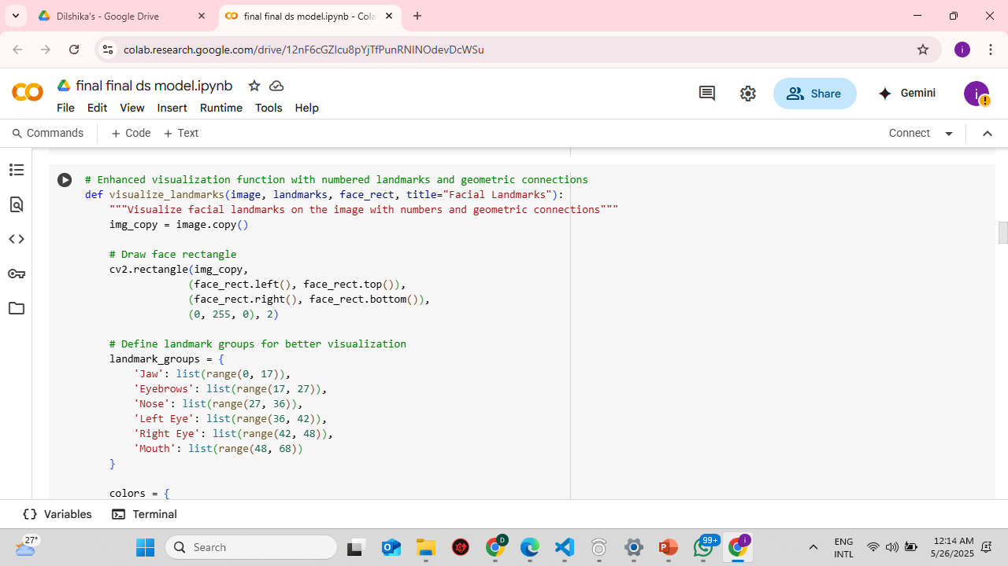
Proof of Concept
Feature Extraction & Landmark displaying
IT21296314 | Kumarasinghe D.P. | 24-25J-228

Slide 26
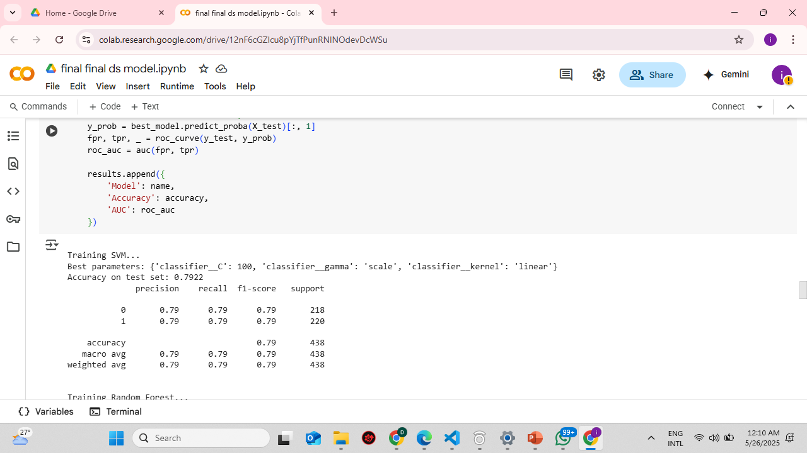
Proof of Concept
Validation, Training & Testing accuracy
IT21296314 | Kumarasinghe D.P. | 24-25J-228

Slide 27
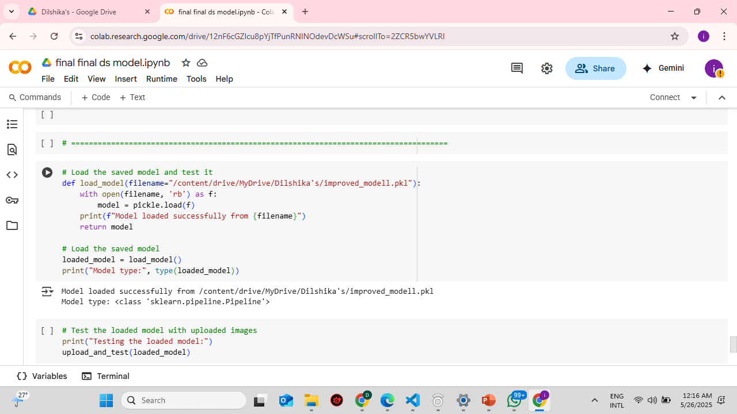
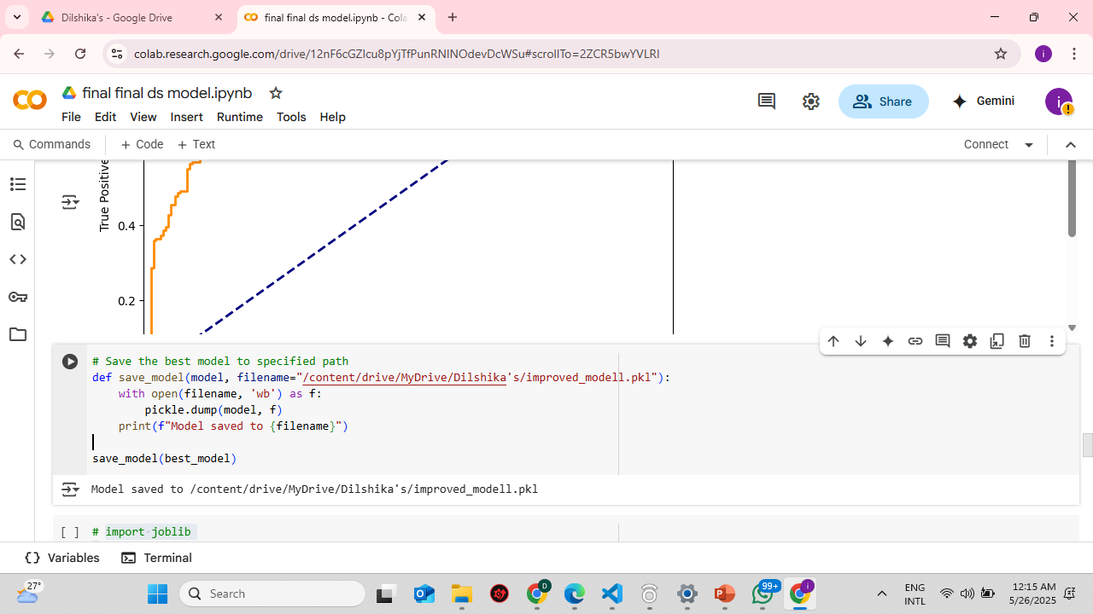
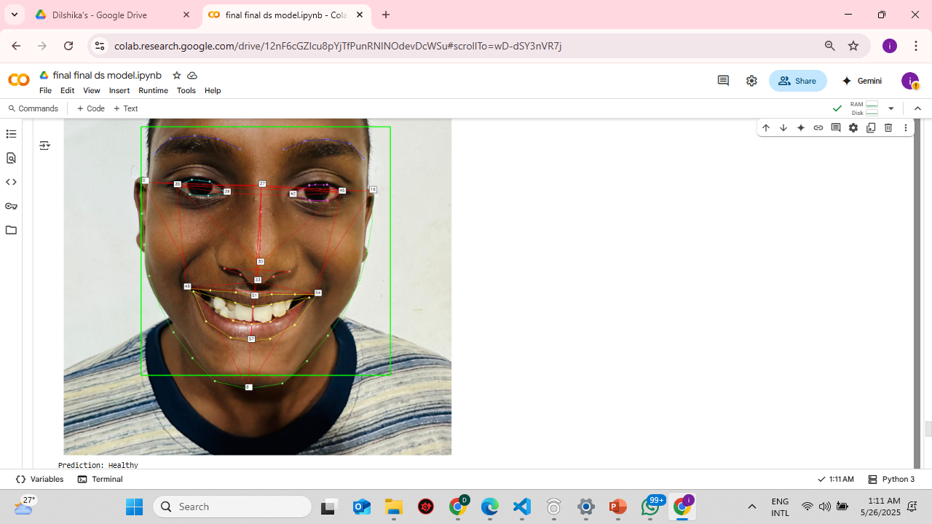
Proof of Concept
Saved the trained model and loaded it back
IT21296314 | Kumarasinghe D.P. | 24-25J-228

Slide 28
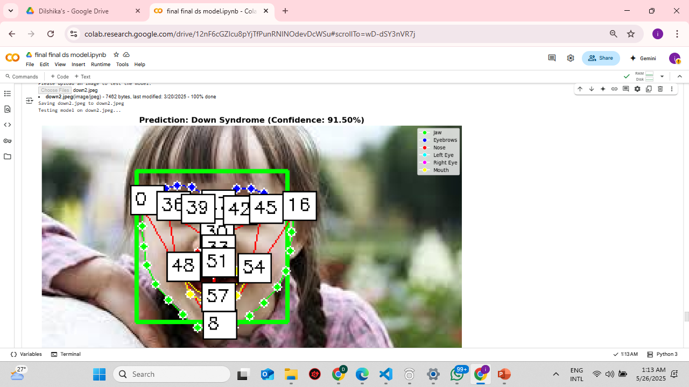
Proof of Concept
Tested the model once its trained
IT21296314 | Kumarasinghe D.P. | 24-25J-228

Slide 29
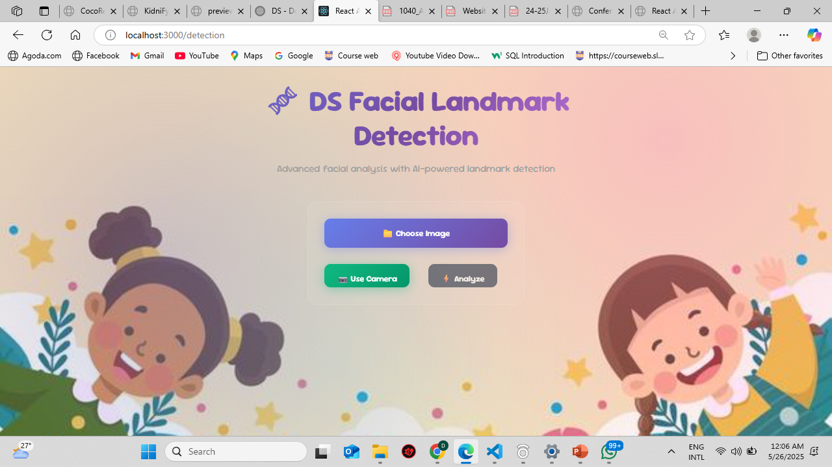
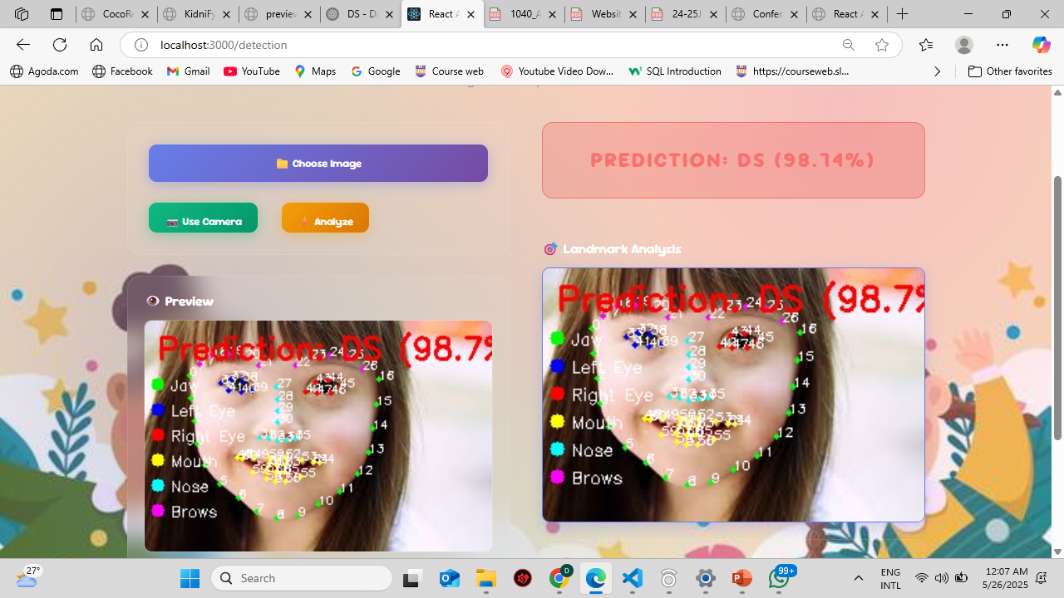
Proof of Concept
IT21296314 | Kumarasinghe D.P. | 24-25J-228

Slide 30
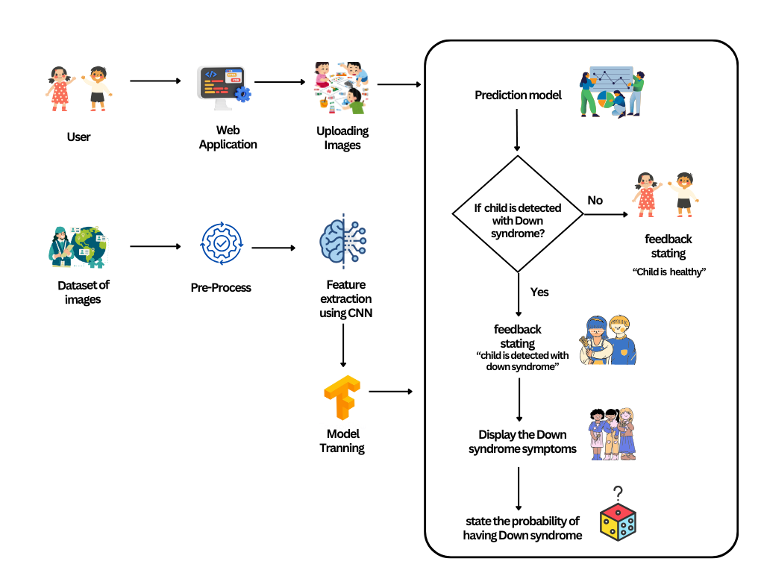
System Diagram
IT21296314 | Kumarasinghe D.P. | 24-25J-228

Slide 31


Functional & Non-functional Requirements
Functional Requirements
Non-Functional Requirements
Enable users to upload images
Ability to assess whether the child is having down syndrome or not
Ability to automatically preprocess uploaded images
Generate a possibility of having down syndrome based from the extracted features
Availability
Reliability
User friendly
High performance
IT21296314 | Kumarasinghe D.P. | 24-25J-228

Slide 32
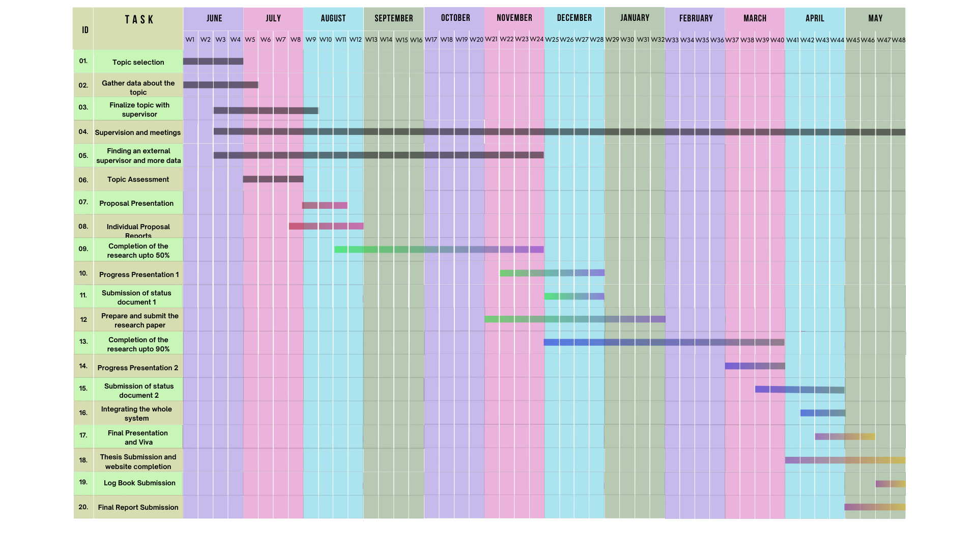
Gantt Chart
IT21293030 Jayasuriya S.H. 25J-228
IT21296314 | Kumarasinghe D.P. | 24-25J-228

Slide 33
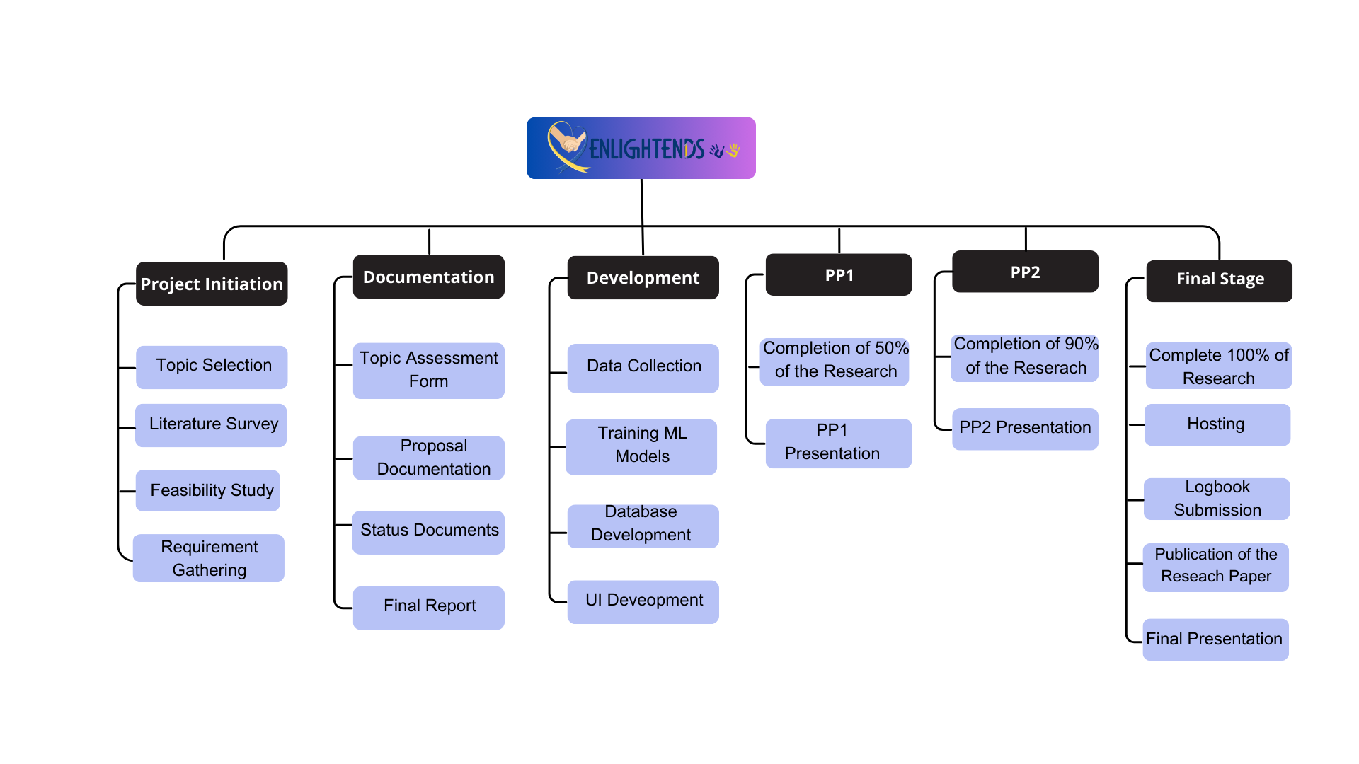
Work Breakdown Chart
IT21293030 Jayasuriya S.H. 25J-228
IT21296314 | Kumarasinghe D.P. | 24-25J-228

Slide 34
References
[4] S. Lanfranchi, O. Jerman, E. Dal Pont, A. Alberti, and R. Vianello, “Executive function in adolescents with Down Syndrome,” Journal of Intellectual Disability Research, vol. 54, no. 4, pp. 308–319, 2010, doi: 10.1111/j.1365-2788.2010.01262.x
[5] M. E. Weijerman and J. P. de Winter, “Clinical practice,” Eur J Pediatr, vol. 169, no. 12, pp. 1445–1452, Dec. 2010, doi: 10.1007/s00431-010-1253-0.
[6] “Rectal polyposis in tuberous sclerosis - GOULD - 1990 - Journal of Intellectual Disability Research - Wiley Online Library.” Accessed: Aug. 11, 2024. [Online]. Available: https://onlinelibrary.wiley.com/doi/abs/10.1111/j.1365-2788.1990.tb01558.x , doi: https://doi.org/10.1111/j.1365-2788.1990.tb01558.x
[7]“(PDF) An Android Augmented Reality Application to Improve Cognitive Skills in Color Recognition for Down Syndrome children.” Accessed: Mar. 17, 2025. [Online]. Available: https://www.researchgate.net/publication/382230056_An_Android_Augmented_Reality_Application_to_Improve_Cognitive_Skills_in_Color_Recognition_for_Down_Syndrome_children, doi :10.47233/jteksis.v6i3.1359
IT21296314 | Kumarasinghe D.P. | 24-25J-228

Slide 35
References
[8] Marcela Tenorio·, Paulina Arango, Andrés Aparicio, December 2023, “BENDI: Improving Cognitive Assessments in Toddlers and Children with Down Syndrome Using Stealth Assessment” https://www.researchgate.net/publication/376508369_BENDI_Improving_Cognitive_Assessments_in_Toddlers_and_Children_with_Down_Syndrome_Using_Stealth_Assessment?_tp=eyJjb250ZXh0Ijp7ImZpcnN0UGFnZSI6InB1YmxpY2F0aW9uIiwicGFnZSI6Il9kaXJlY3QifX0
[9] Yuko Yamauchi , Sayaka Aoki, Junko Koike, November 2018, “Motor and cognitive development of children with Down syndrome: The effect of acquisition of walking skills on their cognitive and language abilities”, https://www.researchgate.net/publication/329260953_Motor_and_cognitive_development_of_children_with_Down_syndrome_The_effect_of_acquisition_of_walking_skills_on_their_cognitive_and_language_abilities
[10] Wajeeha Abdul Ahad·, Fazaila Ehsaan, Noreen Fatima·, February 2020, “Cognitive Impairments in Children with Down Syndrome“ , https://www.researchgate.net/publication/350874523_Cognitive_Impairments_in_Children_with_Down_Syndrome
IT21296314 | Kumarasinghe D.P. | 24-25J-228

Slide 36
IT21293030 | Jayasuriya S.H.
Specialization : Information Technology
Enhancing pronunciation skills in children with down syndrome
IT21293030 | Jayasuriya S.H. | 24-25J-228
IT21293030 Jayasuriya S.H. 25J-228

Slide 37
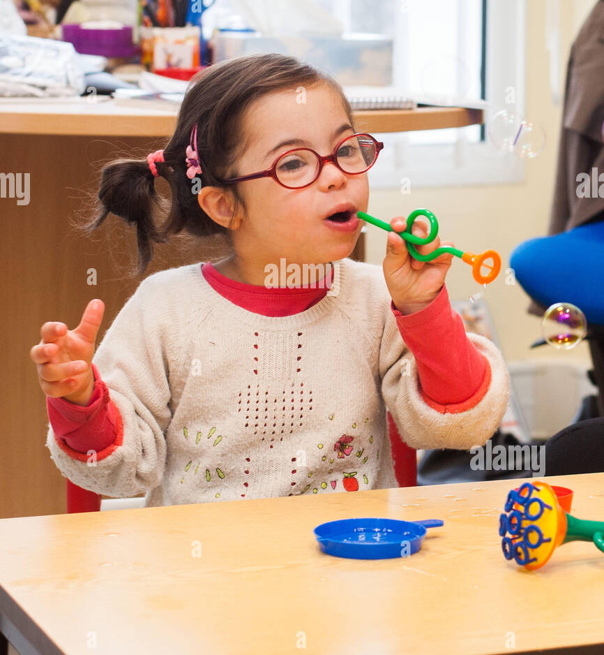
Background
Crucial for effective communication, especially for children with Down syndrome
01
02
Distinct physical features (small nose, upward-slanting eyes) and cognitive delays [11]
The core challenges are delayed speech and limited vocabulary [12]
03
04
Suffer from speech disorders [13]
IT21293030 | Jayasuriya S.H. | 24-25J-228

Slide 38
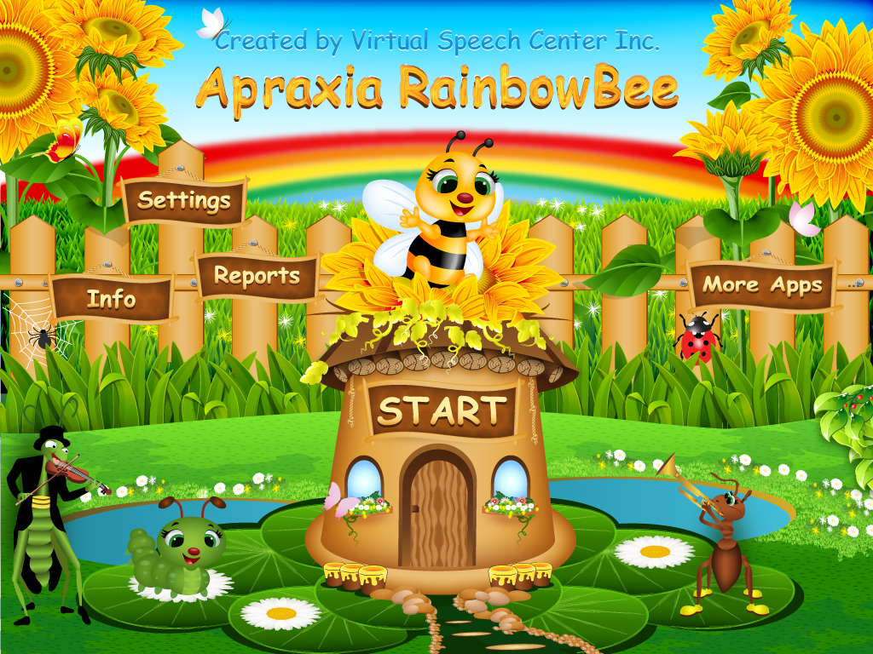
05
Traditional involves repetitive practice; modern uses interactive apps [14]
These five apps—Apraxia Rainbow Bee, Auditory Workout, Articulation Games, Phonological Processes App and The Fun
with R are designed to enhance pronunciation skills
Covers phoneme articulation and auditory processing to benefit children with various speech challenges [15]
06
07
7
IT21293030 | Jayasuriya S.H. | 24-25J-228

Slide 39
Research Gap
Features
[16]
[17]
[18]
[19]
Web Application
Real time emotion Analysis
Access the knowledge level
Emotional based pronunciation practice game
Child voice detection
Technologies (CNN, NLP , OpenCV)
Features
[16] June 1993,” Developing the speech and language skills of teenagers with Down syndrome’’
[17]January 2020, “Design of a Mobile Application for the Learning of People with Down Syndrome through Interactive Games
[18] 2017, “Mobile Speech Therapy Application Using Speech Processing for Intellectually Disabled”
[15] 2007” Teaching Children with Down Syndrome Pronunciations Using Speech Recognition”
IT21293030 | Jayasuriya S.H. | 24-25J-228

Slide 40




Technologies
Natural language processing (NLP)
Convolutional Neural Network (CNN)
TensorFlow
React
Python
OPENCV
IT21293030 | Jayasuriya S.H. | 24-25J-228

Slide 41
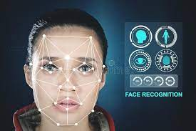
Key Pillars
Image
Processing
Convolutional Neural Network (CNN)
Machine
Learning
Voice
Detection
IT21293030 | Jayasuriya S.H. | 24-25J-228

Slide 42

PP2 to Final progress
Addressing Panel Feedback
Replaced the original audio in the first game with a new recording using my voice but with a clearer accent to improve clarity and ensure correct word pronunciation.
100%
IT21293030 | Jayasuriya S.H. | 24-25J-228 42

Slide 43
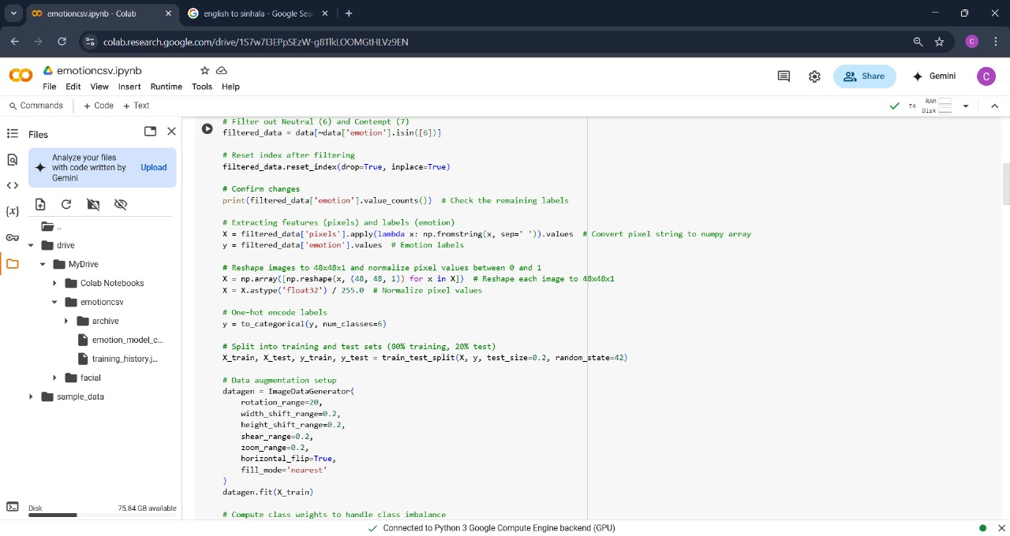
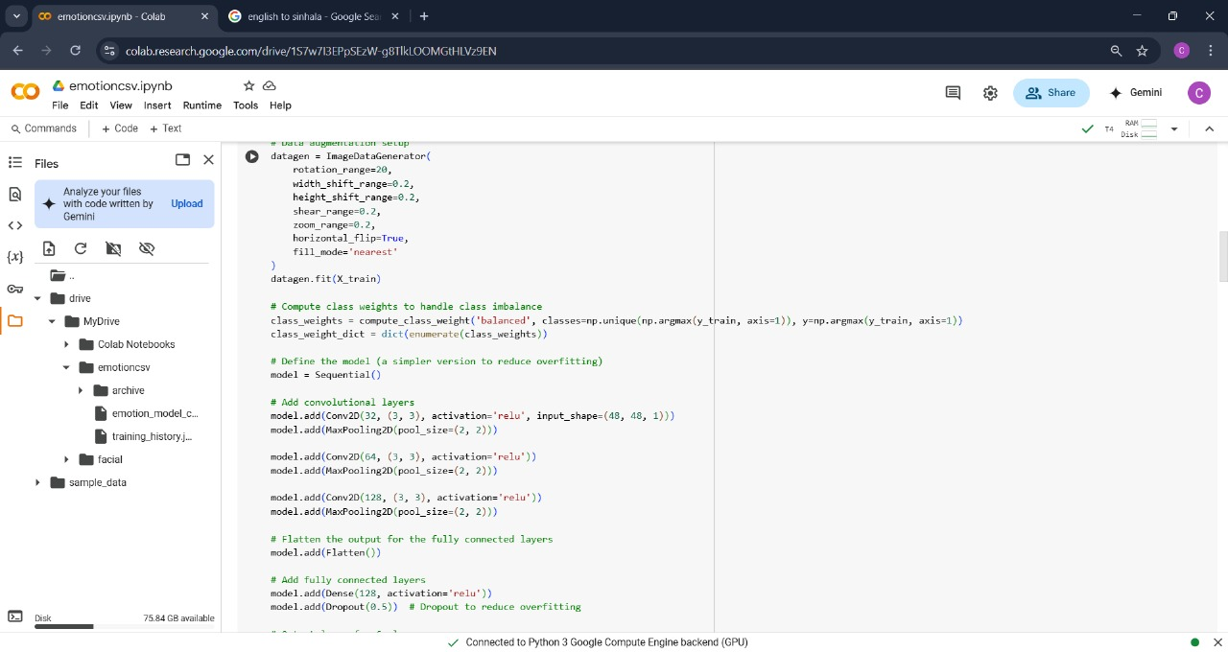
Proof of Concept
IT21293030 | Jayasuriya S.H. | 24-25J-228

Slide 44
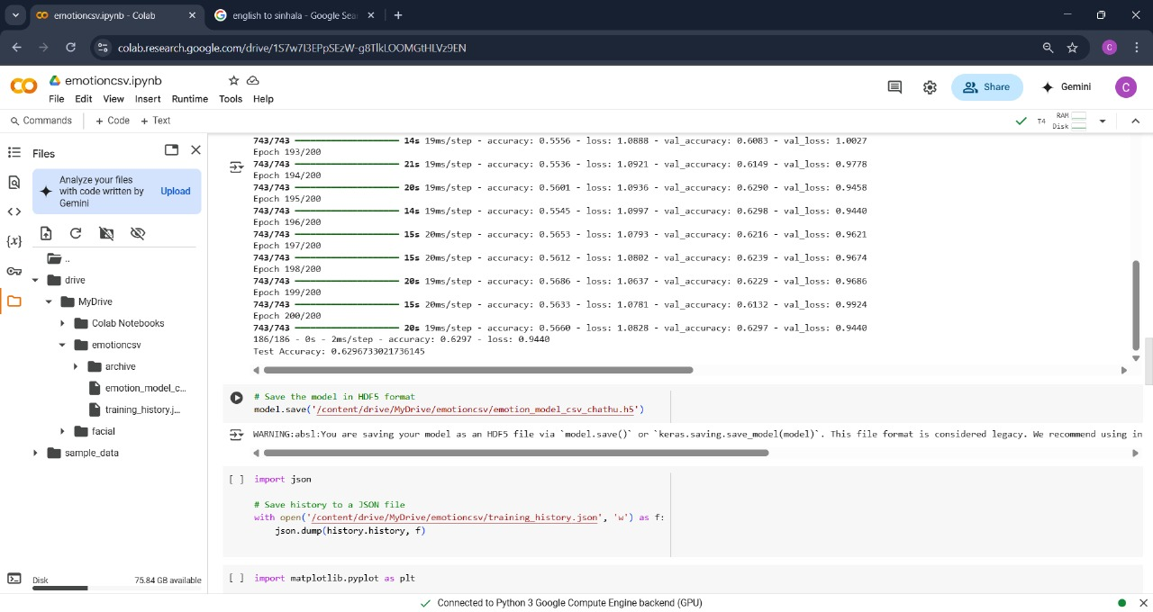
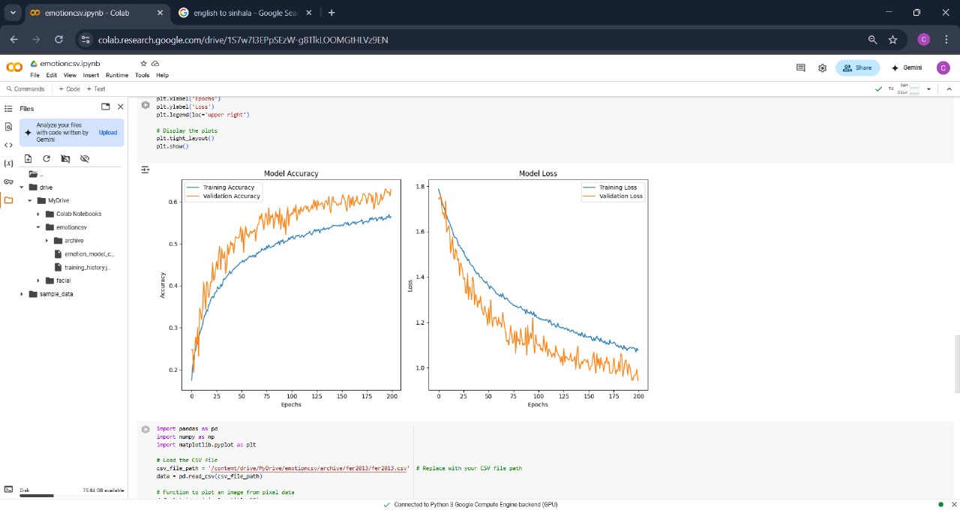
Proof of Concept
IT21293030 | Jayasuriya S.H. | 24-25J-228

Slide 45
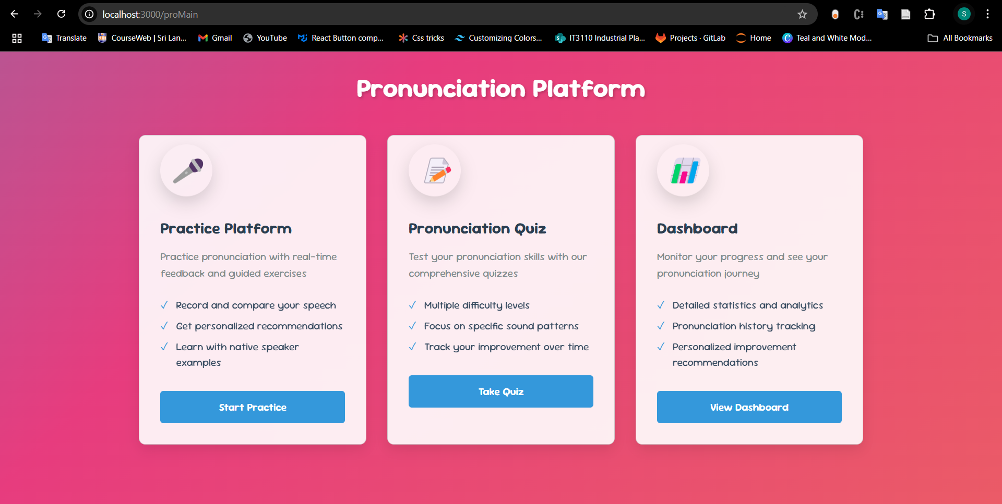
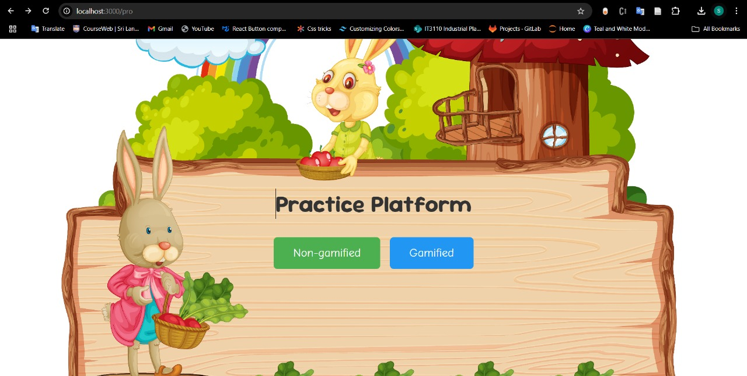
Proof of Concept
IT21293030 | Jayasuriya S.H. | 24-25J-228

Slide 46
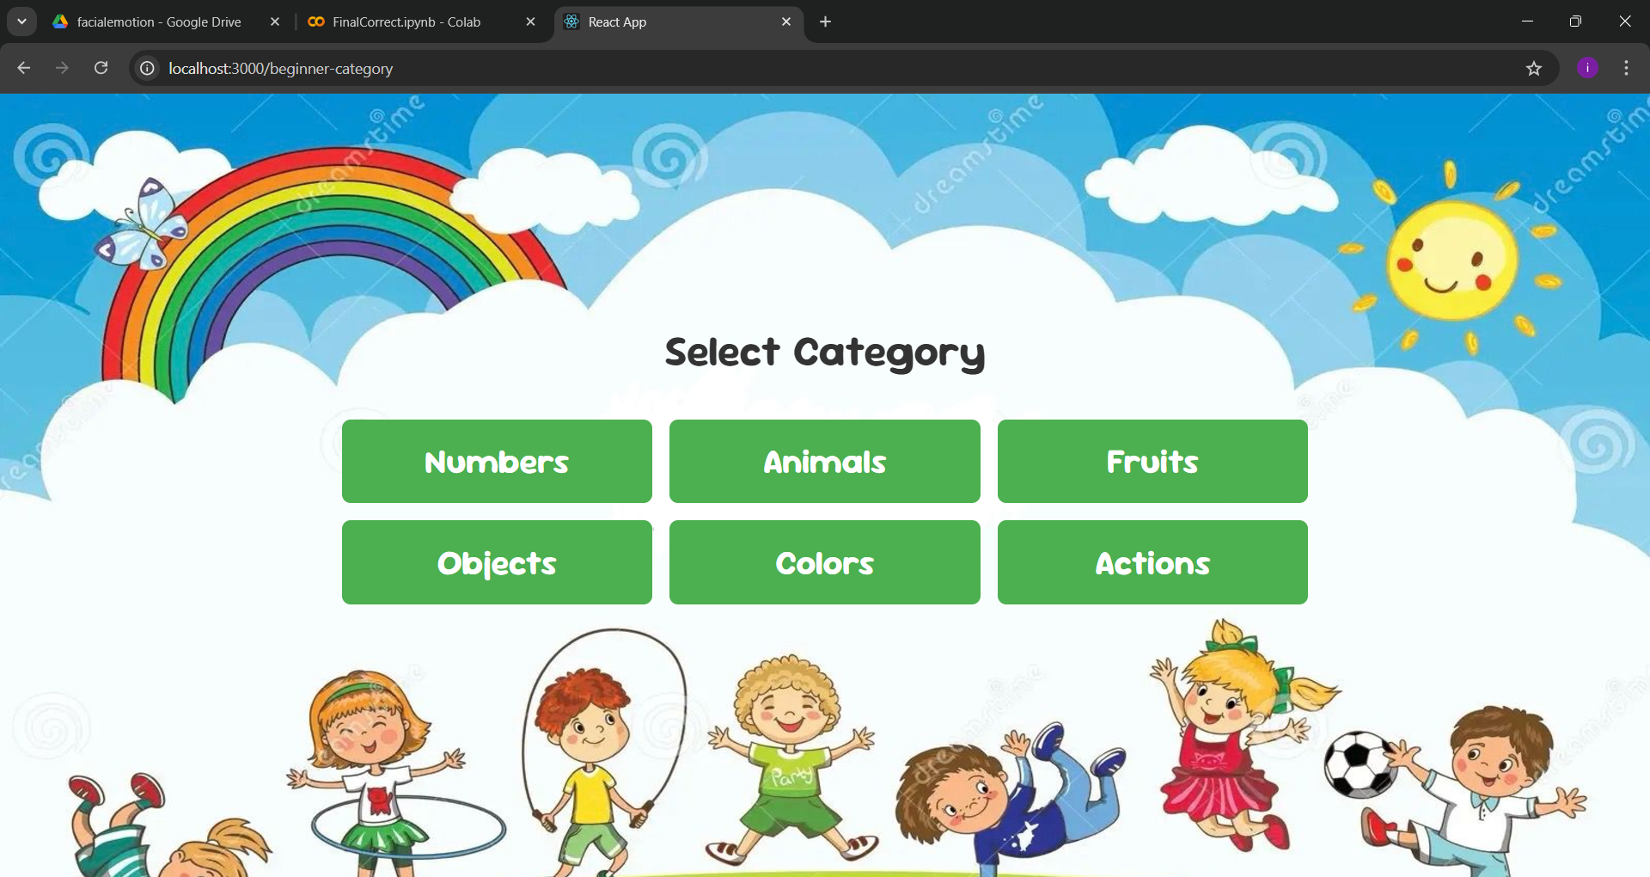
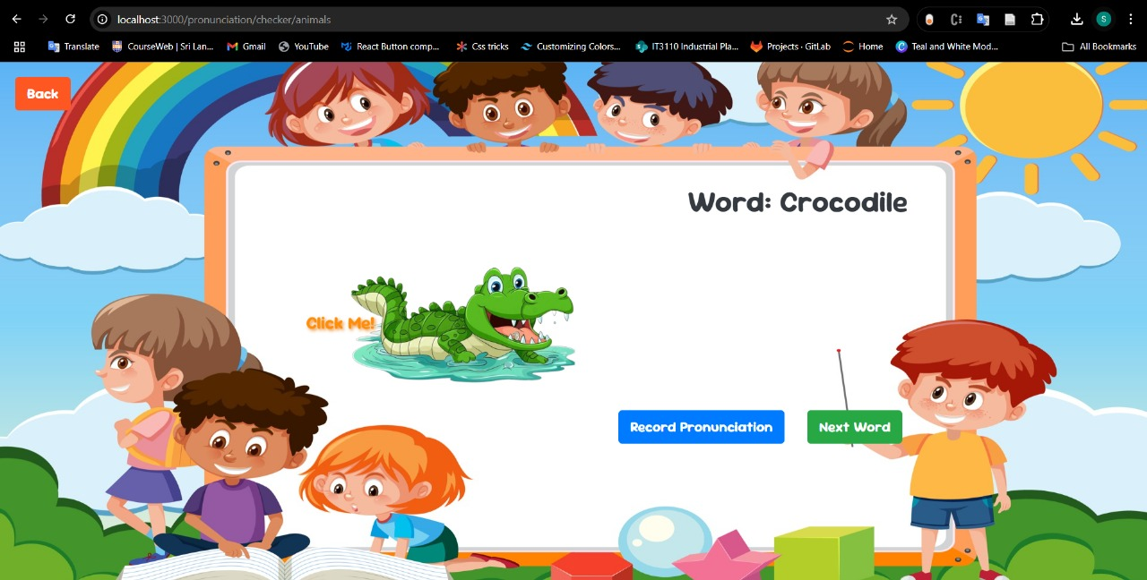
Proof of Concept
IT21293030 | Jayasuriya S.H. | 24-25J-228

Slide 47
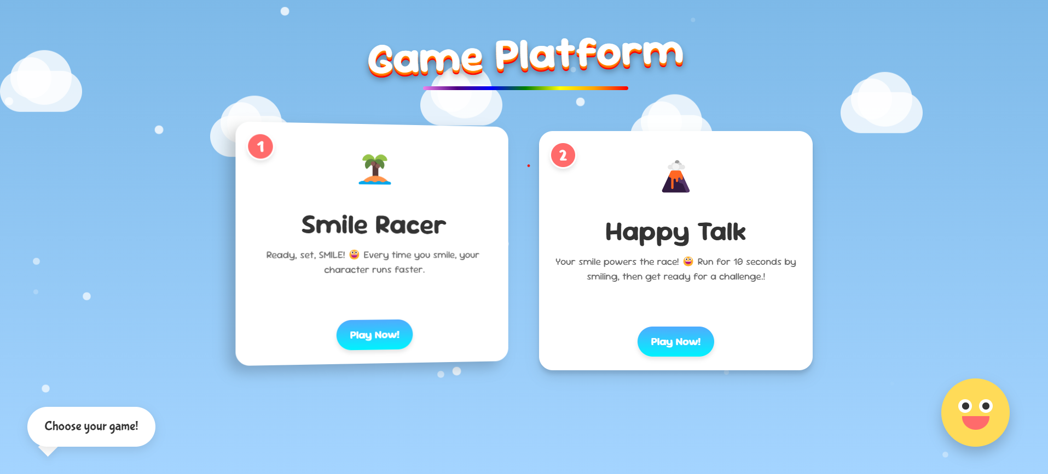
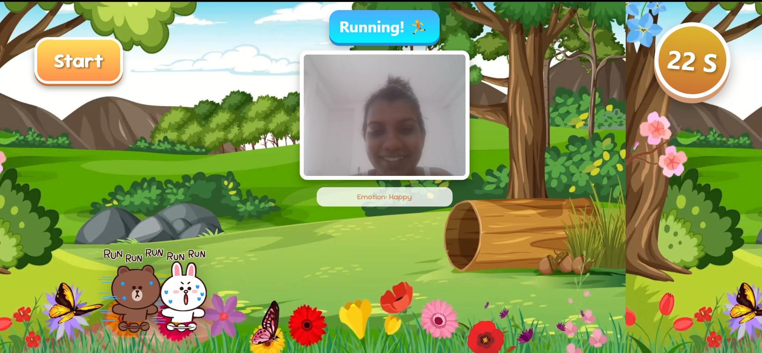
Proof of Concept
IT21293030 | Jayasuriya S.H. | 24-25J-228

Slide 48
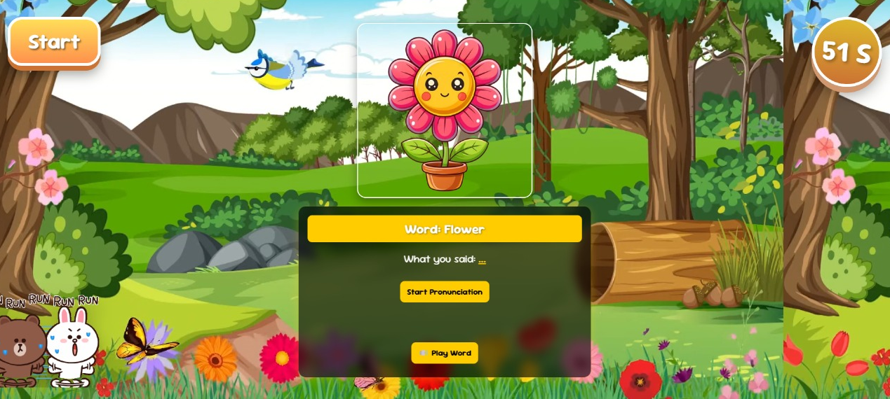
Proof of Concept
IT21293030 | Jayasuriya S.H. | 24-25J-228

Slide 49

System Diagram
IT21293030 | Jayasuriya S.H. | 24-25J-228

Slide 50

Functional & Non-functional Requirements
Functional Requirements
Non-Functional Requirements
Accurately recognize and assess pronunciation.
Provide immediate visual and auditory feedback on pronunciation.
Analyze facial expressions and mouth movements.
Include interactive gamified quizzes to engage the child and make learning enjoyable.
Availability
Reliability
User friendly
High performance
IT21293030 | Jayasuriya S.H. | 24-25J-228

Slide 51
Gantt Chart
IT21293030 Jayasuriya S.H. 25J-228
IT21293030 | Jayasuriya S.H. | 24-25J-228

Slide 52
Work Breakdown Chart
IT21293030 Jayasuriya S.H. 25J-228
IT21293030 | Jayasuriya S.H. | 24-25J-228

Slide 53
References
[11] S. L. Sherman, E. G. Allen, L. H. Bean, and S. B. Freeman, “Epidemiology of Down syndrome,” Mental Retardation and Developmental Disabilities Research Reviews, vol. 13, no. 3, pp. 221–227, 2007, doi: 10.1002/mrdd.20157
[12] N. J. Roizen and D. Patterson, “Down’s syndrome,” The Lancet, vol. 361, no. 9365, pp. 1281–1289, Apr. 2003, doi: 10.1016/S0140-6736(03)12987-X
[13] J. E. Roberts, J. Price, and C. Malkin, “Language and communication development in down syndrome,” Mental Retardation and Developmental Disabilities Research Reviews, vol. 13, no. 1, pp. 26–35, 2007, doi: 10.1002/mrdd.20136
[14] A. Wołowicz-Ruszkowska and D. McConnell, “The experience of adult children of mothers with intellectual disability: A qualitative retrospective study from Poland,” Journal of Applied Research in Intellectual Disabilities, vol. 30, no. 3, pp. 482–491, 2017, doi: 10.1111/jar.12322.
[15] “Ethnic differences in the link between physical discipline and later adolescent externalizing behaviors - Lansford - 2004 - Journal of Child Psychology and Psychiatry - Wiley Online Library.” Accessed: Aug. 11, 2024. [Online]. Available: https://acamh.onlinelibrary.wiley.com/doi/10.1111/j.1469-7610.2004.00273.x
IT21293030 | Jayasuriya S.H. | 24-25J-228

Slide 54
References
[16] Sue Buckley, June 1993,” Developing the speech and language skills of teenagers with Down syndrome’’ https://www.researchgate.net/publication/243131885_Developing_the_speech_and_language_skills_of_teenagers_with_Down_syndrome
[17] Richard Arias-Marreros, Keyla Nalvarte-Dionisio, Laberiano Andrade-Arenas, January 2020, “Design of a Mobile Application for the Learning of People with Down Syndrome through Interactive Games” https://www.researchgate.net/publication/347345266_Design_of_a_Mobile_Application_for_the_Learning_of_People_with_Down_Syndrome_through_Interactive_Games
[18] Fatemah Javadi, Rouhollah Dianat, Vol 11 No 4 (2017)“Mobile Speech Therapy Application Using Speech Processing for Intellectually Disabled”,
https://jmr.tums.ac.ir/index.php/jmr/article/view/133
[19] K. Patel and L. Wong, "Teaching Children with Down Syndrome Pronunciations Using Speech Recognition," in Proceedings of the 2007 IEEE International Conference on Advanced Learning Technologies (ICALT), Niigata, Japan, 2007, pp. 486-488. Available:https://www.researchgate.net/publication/206005894_Teaching_Children_with_Down_Syndrome_Pronunciations_Using_Speech_Recognition.
IT21293030 | Jayasuriya S.H. | 24-25J-228

Slide 55

IT21342394 | Semini B.V.S.
Specialization : Information Technology
Enhancing mathematical skills in children with Down Syndrome
IT21342394 | Semini B.V.S. | 24-25J-228
IT21293030 Jayasuriya S.H. 25J-228

Slide 56

Background
Children with Down Syndrome generally struggle with arithmetic skills
01
02
Numerical skills in these individuals are delayed by two years compared in literacy [20]
03
Teaching methods for numeracy
Kumon Method:
Breaking down learning into small steps.
Stern and Numicon Method:
Uses concrete materials to understand numbers [22]
IT21342394 | Semini B.V.S. | 24-25J-228

Slide 57
Research Gap
Features
[23]
[24]
[25]
[26]
Creating adaptive questioner
Divided questions into difficulty levels
Focus on improving basic numerical skills
Educational animation integration for explanations
Quiz creation
Get overall statistics of performance
Features
[23] January 2021,” Training basic numerical skills in children with Down syndrome using the computerized game “The Number Race”
[24] February 2015, “Mathematics interventions for children and adolescents with Down syndrome: A research synthesis”
[25] 2017, “Comparison of Mathematics Performance of Children and Adolescents with and without Down Syndrome”
[26] December 2016, “The foundations of mathematical development in Williams syndrome and Down syndrome”
IT21342394 | Semini B.V.S. | 24-25J-228

Slide 58


Technologies
Natural language processing (NLP)
TensorFlow
Animaker
React
Python
JavaScript libraries
IT21342394 | Semini B.V.S. | 24-25J-228

Slide 59

Key Pillars
Natural
language processing
Data Preprocessing
Machine
Learning
Gamified Activities
IT21342394 | Semini B.V.S. | 24-25J-228

Slide 60
PP2 to Final progress
Addressing Panel Feedback
Replaced sentence-based explanations with picture-based explanations (animations) as recommended by the panel to enhance visual understanding and engagement
100%
04
IT21342394 | Semini B.V.S. | 24-25J-228 72

Slide 61


Proof of Concept
User Interfaces
IT21342394 | Semini B.V.S. | 24-25J-228

Slide 62



Proof of Concept
IT21342394 | Semini B.V.S. | 24-25J-228

Slide 63



Proof of Concept
IT21342394 | Semini B.V.S. | 24-25J-228

Slide 64




Proof of Concept
IT21342394 | Semini B.V.S. | 24-25J-228

Slide 65




Proof of Concept
Trained a model to determine whether the child is ready to progress to the next difficulty level
IT21342394 | Semini B.V.S. | 24-25J-228

Slide 66





Proof of Concept
IT21342394 | Semini B.V.S. | 24-25J-228

Slide 67


Proof of Concept
IT21342394 | Semini B.V.S. | 24-25J-228

Slide 68




Proof of Concept
Test the trained model
IT21342394 | Semini B.V.S. | 24-25J-228

Slide 69




Proof of Concept
IT21342394 | Semini B.V.S. | 24-25J-228

Slide 70

System Diagram
IT21342394 | Semini B.V.S. | 24-25J-228

Slide 71

Functional & Non-functional Requirements
Functional Requirements
Non-Functional Requirements
Provide quizzes that adjust difficulty based on performance
Include animations that explain concepts step-by-step
Ensure an easy-to-use interface with visual and audio
Track user progress and generate detailed reports
Support multiple users without performance loss.
Make the interface easy to use for all abilities.
Ensure reports accurately reflect user performance metrics.
Design reports to be easy to read and understand.
IT21342394 | Semini B.V.S. | 24-25J-228

Slide 72
Gantt Chart
IT21293030 Jayasuriya S.H. 25J-228
IT21342394 | Semini B.V.S. | 24-25J-228

Slide 73
Work Breakdown Chart
IT21293030 Jayasuriya S.H. 25J-228
IT21342394 | Semini B.V.S. | 24-25J-228

Slide 74
References
[20] “A comparison of mainstream and special education for teenagers with Down syndrome: implications for parents and teachers - PubMed.” Accessed: Mar. 17, 2025. [Online]. Available: https://pubmed.ncbi.nlm.nih.gov/16869376/
[21] J. Hughes, “Learning about number and maths,” Down Syndrome News and Update, vol. 6, no. 1, pp. 10–13, Jan. 2006, doi: 10.3104/practice.374
[22] “Learn at Home Activities for Math,” Down Syndrome Resource Foundation. Accessed: Mar. 17, 2025. [Online]. Available: https://www.dsrf.org/resources/learn-at-home/learn-at-home-activities-for-math/
[23] F. Sella, S. Onnivello, M. Lunardon, S. Lanfranchi, and M. Zorzi, “Training basic numerical skills in children with Down syndrome using the computerized game ‘The Number Race,’” Sci Rep, vol. 11, no. 1, p. 2087, Jan. 2021, doi: 10.1038/s41598-020-78801-5
[24] “(PDF) Mathematics interventions for children and adolescents with Down syndrome: A research synthesis,” ResearchGate, Oct. 2024, doi: 10.1111/jir.12188
IT21342394 | Semini B.V.S. | 24-25J-228

Slide 75
References
[25] “(PDF) Comparison of Mathematics Performance of Children and Adolescents with and without Down Syndrome,” ResearchGate. Accessed: Mar. 17, 2025. [Online]. Available: https://www.researchgate.net/publication/316940866_Comparison_of_Mathematics_Performance_of_Children_and_Adolescents_with_and_without_Down_Syndrome
[26] Jo Van Herwegen, PhD1 Erica Ranzato1 Annette Karmiloff-Smith, PhD Victoria Simms, December 2016, “The foundations of mathematical development in Williams syndrome and Down syndrome” https://discovery.ucl.ac.uk/id/eprint/10096606/1/Van%20Herwegen_Mathematical%20development%20in%20Williams%20syndrome%20and%20Down%20syndrome%20accepted.pdf
IT21342394 | Semini B.V.S. | 24-25J-228

Slide 76

IT21292972 | Methsahani K.K.S.P
Specialization : Information Technology
Identify the interests and talents of children with down syndrome
IT21292972 | Methsahani K.K.S.P. | 24-25J-228
IT21293030 Jayasuriya S.H. 25J-228

Slide 77

Background
01
Implement a system to identify and nurture talents in children with Down syndrome.
02
Focus Areas: Motor skills, learning skills and painting skills.
Down syndrome children talented for one specific area. According to the previous research works there’s no proper system to identify that talent.[27][28][29]
03
04
Most research focuses on the challenges faced by children with Down syndrome[27].
IT21292972 | Methsahani K.K.S.P. | 24-25J-228

Slide 78
Research Gap
Features
[27]
[28]
[29]
[30]
[16]
[17]
Identify learning skill
Identify recital skill
Identify the talented area
Identify drawing skill
Generate quiz using AI
[27] Jan. 2015, “Need Analysis for Down Syndrome Children to Develop a Learning Material on Numbers with the Aid of Multimedia Technology,”
[28] 2021, “Chapter Four - The emergence of fine motor skills in children with Down syndrome”
[29]2022, "E-Learning Education System For Children With Down Syndrome”
[30]2023, "Beyond Question Shuffling: Randomization Techniques in Programming Assessment"
IT21292972 | Methsahani K.K.S.P. | 24-25J-228

Slide 79

Technologies
Artificial Intelligent
(AI)
Python
libraries
React
JavaScript libraries
IT21292972 | Methsahani K.K.S.P. | 24-25J-228

Slide 80

Key Pillars
Artificial Intelligent
(AI)
Machine
Learning
Image
Processing
IT21292972 | Methsahani K.K.S.P. | 24-25J-228

Slide 81
PP2 to Final progress
Addressing Panel Feedback
Removed the math section based on panel feedback and expanded the language category into two distinct sections to enhance content variety
Got the data from database and displayed the talented area which is identified via the model
100%
IT21292972 | Methsahani K.K.S.P. | 24-25J-228

Slide 82


Proof of Concepts
Code level implementation and Main category selection interface
IT21292972 | Methsahani K.K.S.P. | 24-25J-228

Slide 83


Proof of Concepts
Learning category Interfaces
IT21292972 | Methsahani K.K.S.P. | 24-25J-228

Slide 84


Proof of Concepts
Interfaces of quiz generation using AI
IT21292972 | Methsahani K.K.S.P. | 24-25J-228

Slide 85


Proof of Concepts
Piano platform interface
Drawing platform interface
IT21292972 | Methsahani K.K.S.P. | 24-25J-228

Slide 86


Proof of Concepts
Talent identify interface
IT21292972 | Methsahani K.K.S.P. | 24-25J-228

Slide 87


Proof of Concepts
Model Training
Analyzation testing using postman
IT21292972 | Methsahani K.K.S.P. | 24-25J-228

Slide 88

System Diagram
IT21292972 | Methsahani K.K.S.P. | 24-25J-228

Slide 89


Functional & Non-functional Requirements
Functional Requirements
Non-Functional Requirements
Ability to select categories.
Quiz generation.
Data Analysis according to the user inputs.
Send notification to parent.
Performance
Reliability
Usability
Maintainability
IT21292972 | Methsahani K.K.S.P. | 24-25J-228

Slide 90
Gantt Chart
IT21293030 Jayasuriya S.H. 25J-228
IT21292972 | Methsahani K.K.S.P. | 24-25J-228

Slide 91
Work Breakdown Chart
IT21293030 Jayasuriya S.H. 25J-228
IT21292972 | Methsahani K.K.S.P. | 24-25J-228

Slide 92
References
[28] J. Janier, A. Shafie, M. Taha, N. Mohamad, W. F. Wan Ahmad, and R. Lob Yussof, “Need Analysis for Down Syndrome Children to Develop a Learning Material on Numbers with the Aid of Multimedia Technology,” International Journal of Social Science and Humanity, vol. 5, pp. 107–111, Jan. 2015, doi: 10.7763/IJSSH.2015.V5.433.
[29] A. W. Needham, E. L. Nelson, A. D. Short, L. A. Daunhauer, and D. J. Fidler, “Chapter Four - The emergence of fine motor skills in children with Down syndrome,” inInternational Review of Research in Developmental Disabilities, vol. 60, R. M. Hodapp and D. J. Fidler, Eds., Academic Press, 2021, pp. 113–151. doi: 10.1016/bs.irrdd.2021.08.002.
[30] A. S. T. Sampath, M. W. Vidanapathirana, T. B. A. Gunawardana, P. W. H. Sandeepani, L. H. S. S. Chandrasiri, and B. Attanayaka, “E-Learning Education System For Children With Down Syndrome,” in 2022 IEEE 10th Region 10 Humanitarian Technology Conference (R10-HTC), Sep. 2022, pp. 450–455. doi: 10.1109/R10-HTC54060.2022.9929446.
[31] H. Hickman, P. McKeown, and T. Bell, “Beyond Question Shuffling: Randomization Techniques in Programming Assessment,” in 2023 IEEE Frontiers in Education Conference (FIE), Oct. 2023, pp. 1–9. doi: 10.1109/FIE58773.2023.10342976.
IT21292972 | Methsahani K.K.S.P. | 24-25J-228

Slide 93
THANK YOU!

